Slide 1
Chapter 3
0
Strategic Advantage 5 Competitive Forces

Slide 2
Strategic Information Technology
0
Technology is not an afterthought
Technology drives business strategy.
Information Technology changes the way businesses compete.

Slide 3
Strategic View
0
Information systems are vital competitive networks.
Information systems enable organizational renewal.
Information systems enable a business to quickly reengineer or reinvent

Slide 4
Porter’s Competitive Forces
0
Rivalry of competitors within an industry
Threat of new entrants into an industry
Threat of substitute products to “steal” market share
Bargaining power of customers
Bargaining power of suppliers

Slide 5
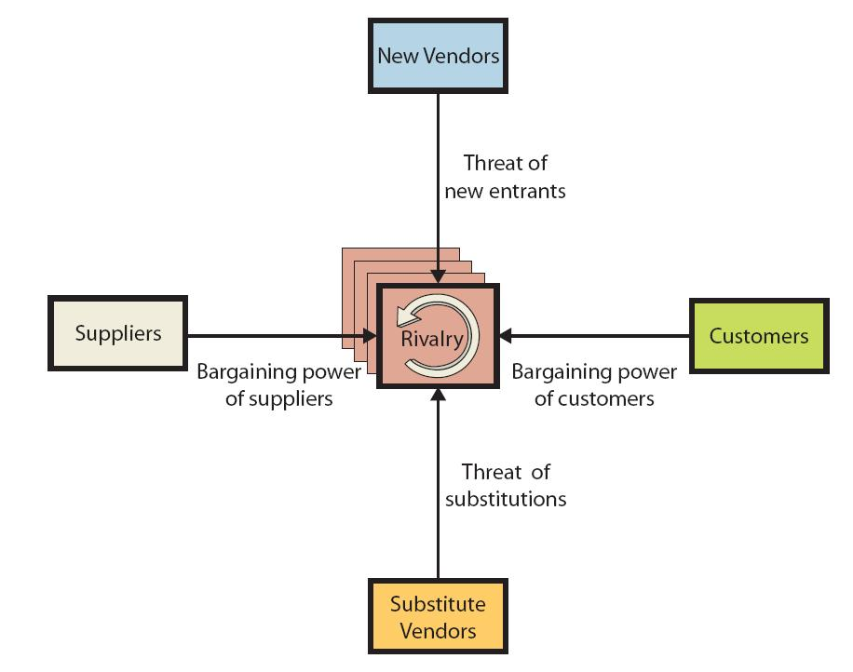

Slide 6
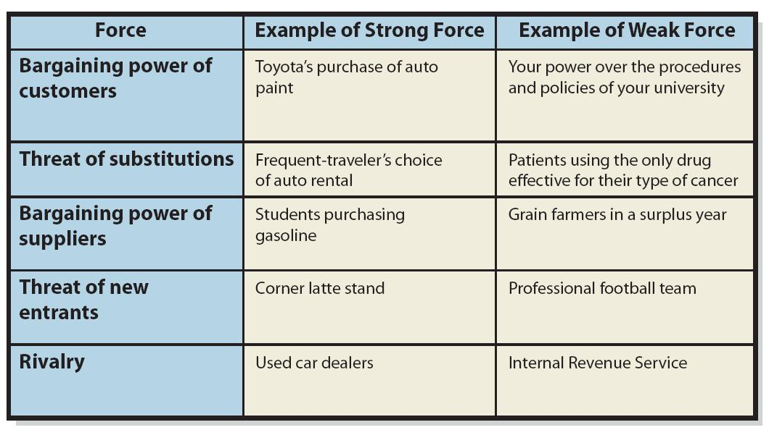

Slide 7
Rivalry of competitors
0
Online-shopping, E-commerce, Price comparison tools increase rivalry.
Industries with high rivalry?
Industries with low rivalry?

Slide 8
Threat of new entrants
0
E-commerce enables a business to emerge overnight
A medium-sized retail store can become a global E-commerce competitor at little cost.
Whereas, it costs a lot to become a global donut competitor

Slide 9
Substitute Products
0
Internet & technology makes substitutes easier to find.
Can’t afford to fly ... take a train.
iPhone too expensive ... buy a MotoZ

Slide 10
Bargaining power
0
Customer:
E-commerce has empowered the customer
Examples:
Ebay
Lending Tree
Reverse auctions
Drives prices down!
Suppliers:
Example: A major supplier can force retailers to use their Supply Chain Management System.
Pushes costs on to the retailer
More profit for the suppliers

Slide 11
Competitive Strategies
0
Cost Leadership
Differentiation
Innovation
Growth
Alliance

Slide 12
0

Slide 13
Cost Leadership Strategy
0
Using information technology to become the lowest-cost provider of products and services
Using IT to reduce costs
Example: Dell
Leveraging IT investments to drive up costs for the competition
Example: Apple

Slide 14
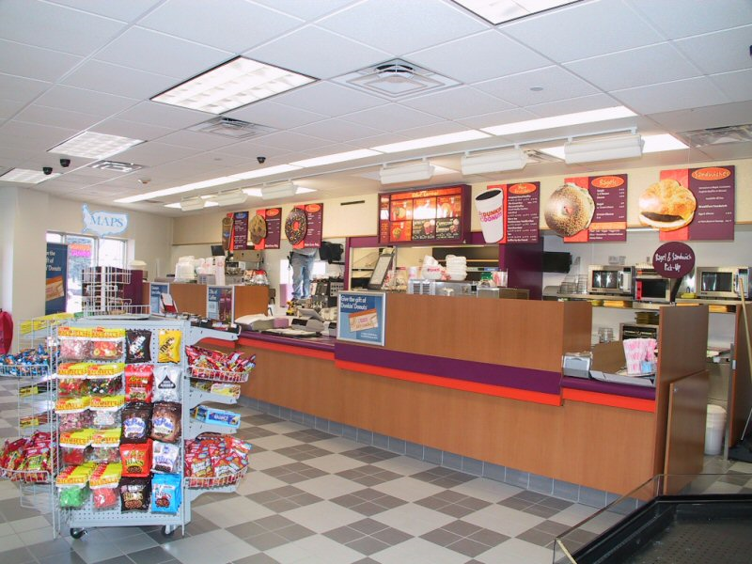
Differentiation Strategy
0
Developing ways to differentiate products and services from the competitors’
Example: Starbuck vs. Dunkin Donuts

Slide 15
Innovation Strategy
0
Development of unique products and services
Entry into a unique market
Making radical changes that alter the fundamental structure of an industry

Slide 16
Growth Strategy
0
Significantly expanding capacity to produce goods and services
Expanding into global markets
Diversifying into new products and services
Integrating into related products and services
E-commerce: enables Global Reach for small companies

Slide 17
Alliance Strategy
0
Establishing new business linkages and alliances with
customers,
suppliers,
competitors,
consultants, etc.
Supplier and Retailer sharing information systems, sharing IT infrastructure.

Slide 18
CLASSIC Examples
0
Cost Leadership:
Priceline.com
Bidding
Buyer set pricing

Slide 19
CLASSIC Examples
0
Innovation:
E-trade
Online discount stock trading
Market leader in 2000, but then they collapsed because everyone else entered the market.

Slide 20
Examples
0
Growth:
Walmart
Streamlining supply chain and distribution so they can open stores everywhere at minimal cost.
Beer, diapers, discount beef jerky, country music, NASCAR merchandise, cheap plastic furniture, and every ingredient you need to make napalm (all at low prices).

Slide 21
Examples
0
Differentiation:
Moen & Lego
Online customer design
Increase in market share

Slide 22
Examples
0
Alliance:
Wal-Mart & Proctor N’ Gamble
Beer, diapers, discount beef jerky, country music CD’s, NASCAR merchandise, cheap plastic furniture, every ingredient you need to make napalm, and oxycontin (all at low prices).
Outcome: Market gains as a Pharmacy

Slide 23
Advantage vs. Necessity
0
Competitive Advantage – developing products, services, or capabilities that give a company a superior business position relative to its competitors
Competitive Necessity – developing products, services, or capabilities that are simply necessary to do business in an industry

Slide 24
Business Process Reengineering (BPR)
0
Fundamental rethinking and radical redesign of business processes to achieve dramatic improvements in cost, quality, speed, and service.

Slide 25
Business Improvement (BI)
BI: Companies are always trying to improve, but most improve incrementally.
This is necessary to compete.
BPR: Business Process Re-engineering is more than just BI…
BPR involves radical change
BPR is done to achieve competitive advantage

Slide 26
0

Slide 27
Agility
0
The ability of a company to prosper in rapidly changing market
market demands high-quality, high performance, customer-configured products and services.
Information Systems can improve a companies Agility.

Slide 28
Agile Company
0
Definition:
A company that can make a profit in markets with
broad product ranges
short model lifetimes
can produce orders individually and in arbitrary lot sizes.

Slide 29
Mass Customization
0
Definition:
Providing individualized products while maintaining high volumes of production
Think about how Information System can help a company achieve Mass Customization initiatives???

Slide 30
Value Chain
0
Definition:
All companies are just a series or chain of basic activities that… add value to its products and services,
Raw Material → Add Value → Products/Services

Slide 31
0

Slide 32
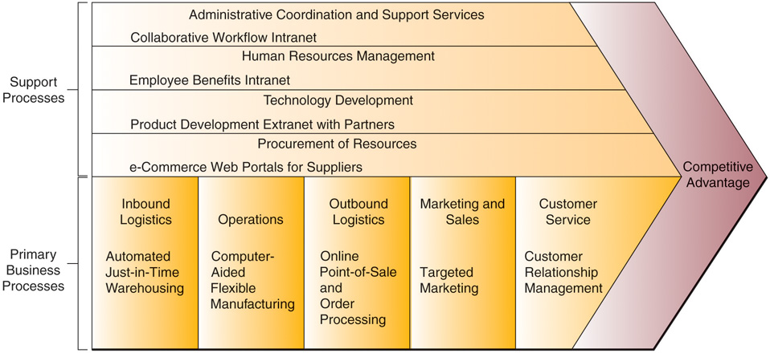
IS & The Value Chain
Integrate the value chain in multiple Companies
Wrap With US
SalesForce.com
RobotWorx
General Plastics
Amazon.com

Slide 33
Customer-Focused Business
0
A business that:
can anticipate customers’ future needs.
responds to customer concerns.
provides top-quality customer service.

Slide 34
0

