Slide 1
Database Management Systems (DBMS)
Examples: Oracle, MS Access vs
SpreadSheets (SS)
Examples: Excel, Google Sheets
Learning about software Interfaces

Slide 2
Software Interfaces
In lab we examined
  Excel Spreadsheet Interface
  Access Database Interface
We also learned about User Interface Design
  Part of an area of research called Human Computer Interaction (HCI)
Notes:
We’ll first learn about what is important in User Interfaces
We’ll look at Excel and Access to see how they are different.
We’ll build an interface in Access

Slide 3
Commonality of DBMS and SS
Both DBMS and SS can
  store data
  sort data
  perform calculations
  search data (lookup or query)
But it’s very easy to pick
the wrong application for the job
Notes:
DB and SS can both store sort and query data
Confusing to determine which application is right for the job

Slide 4
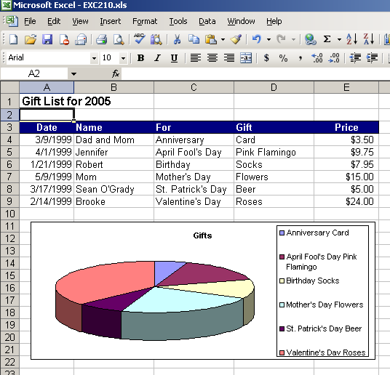
What is a Spreadsheet?
Stores data in a grid of cells
Focus:
Numerical Calculations
Formatting Data
Graphing Data
Notes:
Spreadsheet used for mostly numerical data
Can manipulate data in many ways
Display graphs very easily

Slide 5
Database vs. Spreadsheet
Spreadsheets: few rules
  Data can go in any cell
  Easy to copy anything to anywhere
  Rows and columns are not logically connected
Databases: strict structure
  Rows and columns have meaning
  Rows are “entities”
  Columns are “attributes”
Notes:
Interface for a spreadsheet is something all of you have seen:
grid of cells
menu at top
They are easy to learn and more of an individual tool
that is why they might be used incorrectly instead of a db

Slide 6
Use Spreadsheets for:
Complex computations on smaller set of data.
What if analysis
Visual presentation of data, usually exported to formal reports
Notes:
Used for computations if the data set is small
What if analysis
you might have seen this in 010 class or spreadsheet class
goal seek – where you change one variable to get a value for another variable
the application is usually buying a car
These projects usually are individual efforts – only one person would be working on a spreadsheet
especially at one time.

Slide 7
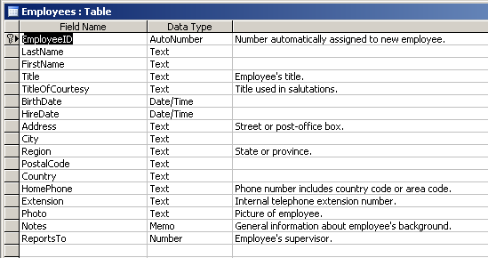
What is a Database?
A database is an integrated collection of logically related data elements.
Notes:
Database is a collection of tables
In the picture, employees table is defined
Field name, data type and description METADATA!

Slide 8
Database Interface
Database Interface is
  Complex, not intuitive
  Many components (tables, queries, reports...)
  Relatively complex menus
  Access has powerful wizard support
  Highly customizable
Notes:
Database is very complex and has many components
as we will see in lab
Access is a little different than most databases
Because you can see the datasheet.
In most databases, there isn’t an option to look at a table
The only way you can see data in a table is if you query the table.
This is very confusing the first time you use a db after using access
Highly customizable – point of a database
it’s the use’s job to make the most of the database

Slide 9
Why use a database to store data?
Need multi-user access
Large amounts of data
Keep your data safe
  Preserve data integrity, use data validation
Avoid data redundancy and inconsistency
  Data can be updated in one place and only takes up as much space as needed
Notes:
Why would you go through the trouble of using a database
when its so complex.
Can handle large amounts of data – millions of customers, can’t use excel
Databases have the tools within them for security
Avoid redundancy, which is important and we’ll see in lab
We don’t want to repeat data in more than one place
name, phone number
If something changes, like a phone number and its stored in
2 spreadsheets or two tables, you’ll have to change it in both places
In database, you can easily store it in one place and only have to update
One time.

Slide 10
Core Message of this lab
Many companies and organizations use spreadsheets because employees are
  familiar with Excel
    has a more intuitive user interface
  not familiar with DBMS
    has many, many advanced features
    complex user interface
    not easy to do simple tasks
But, DBMS should be used instead of Excel for many core business processes
Notes:
Spreadsheets and databases both have their place.
If an application isn’t working for you, its probably the interface
That’s what we’ll talk about next.

Slide 11
Database Management Systems
(DBMS) vs
SpreadSheets (SS)
What makes for a good user interface?

Slide 12
What is a user interface?
Everything involved in using a program
  from the mouse to menus to messages
Goal of the user interface?
  Make the user's experience productive, efficient, effective, and humane.

Slide 13
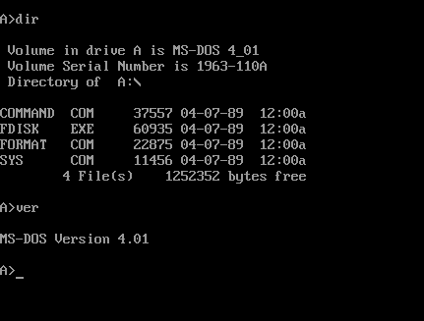
Early Computers…
  Required great effort to
  master the interface.
Notes:
User Interfaces have changed many people’s lives.
Customer service reps handle your calls better
pilots can fly airplanes more safely
children can learn more effectively
Down side to ineffective user interfaces: frustration, fear,
failure when they encounter excessively complex menus,
chaotic navigation paths.
Windows used to run on top of DOS. Now it’s a DOS emulator
Used to have to run games in DOS.
all there was to the user interface was a > symbol and a blinking cursor. And the screen was monochrome--either light orange or bright green on a dark grey background. The rest was up to you and your imagination.

Slide 14
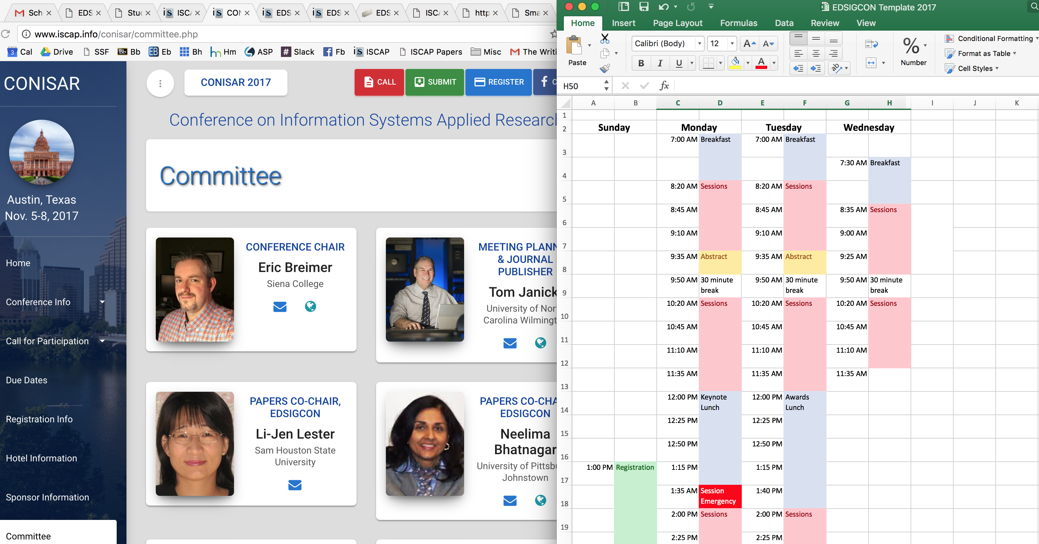
Today user interfaces
  Easier for novices to use
  Richer visual cues
  Shift from Mouse to Touchscreen controls
  Moving toward complex but now moving back to simple
Notes:
This would be a good time to ask the class what interfaces they enjoy working with and ones
that frustrate them. The examples may include websites, computer programs, games, ATMS, card readers, etc…
Blackboard: to create a quiz is totally different than making an assignment.
The controls are all over the place.
Bad: blackboard’s gradebook.
Commands to reorder the columns is in one place, command to create a new column is completely different.
You can’t add one grade to a percentage of another grade –
reason you have so many columns.
I also hate the credit card reader at the gas station –
it always asks you if you want a car wash, it can’t tell if my card is debit or credit.

Slide 15
What characteristics are most effective in a user Interface?
The Eight Golden Rules of
Interface Design
(CRUCIFEM)

Slide 16
Strive for Consistency
The same actions should produce the same outcome every time.
In Access, two buttons that appear the same can do very different things based on the context (some consider Access to be very inconsistent)
Notes:
Consistent sequences of actions should be required in similar situations –
this is why Excel is often much easier for students to learn.
The sequence of many actions is similar to Word a program
most students are already familiar with. However, Access is very different causing some frustration when learning it.
Identical terminology should be used in prompts, menus, help screens, and consistent color, layout, capitalization, fonts, etc.

Slide 17
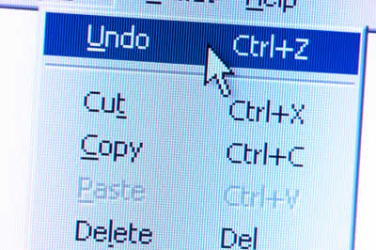
Easy Reversal of Actions
Users often select functions by mistake and need an emergency exit.
In Access, some action queries cannot be undone.
Notes:
Users often choose system functions by mistake and need a clearly
marked "emergency exit" to leave the unwanted state without having to
go through an extended dialogue. Support undo and redo.

Slide 18
Universal Usability
Consider the needs of diverse kinds of users
Novice to expert users
  Age ranges
  Disabilities
Excel requires little knowledge to use for simple tasks, but also supports features for expert usage.
Access is not designed for novice use.
Notes:
Different types of users should be taken into consideration.
For novice users, there should be explanations, help button.
For experienced users, there should be short cuts and faster pacing.

Slide 19




Move towards Completion
Tasks should be organized into logical groups with a beginning, middle and end.
A “Wizard” interface supports step-by-step completion of task.
Access has this for some tasks.
Notes:
Transactions should have a beginning, middle and end.
Example e-commerce site that moves the user through each process of purchase.
On some e-commerce sites, they’ll show you your progress, with
Completed steps greyed out and the current step in bold and future steps.
Feedback should be offered when each step is completed.
Don’t want to be lost in no man’s land with no end in site.
Dialogs should be designed to yield closure.

Slide 20
Support an Internal Locus of Control (User Task Focus)
The user should feel in control of the environment, not reacting to it.
The user interface should NOT:
Change unexpectedly
Require un-necessary steps
Make it hard to find relevant menus and buttons
The above items quickly build anxiety and dissatisfaction.
Notes:
User should be in control.
Should not have to enter the same data over again
Shouldn’t be hard to find tools you need

Slide 21
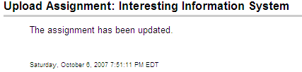
Offer Informative Feedback
For every action, there should be some sort of system feedback.
Notes:
Feedback – you should feel secure that you completed a task successfully
Especially if it includes your credit card number.
Message or box pop up saying “you did this successfully”.
Blackboard does this to the extreme. Any little action you have to click a stupid “ok” button.
“You did this successfully” button.

Slide 22
Prevent Errors
As much as possible, the system should be designed so users can’t make serious errors.
How can a system be designed to do this?
How do you know if it has been?
The system should detect data inconsistencies / errors and offer simple guidance for recovery.
Compared to Excel, Access is a better tool for preventing data entry errors.
Notes:
Even better than good error messages is a design that prevents a problem
from occurring in the first place.
A system can be designed to prevent errors by not allowing inaccurate data from being entered.
We’ll see this in lab
When errors are made the error messages should be expressed
in plain language (no codes), precisely indicate the problem, and constructively suggest a solution.

Slide 23
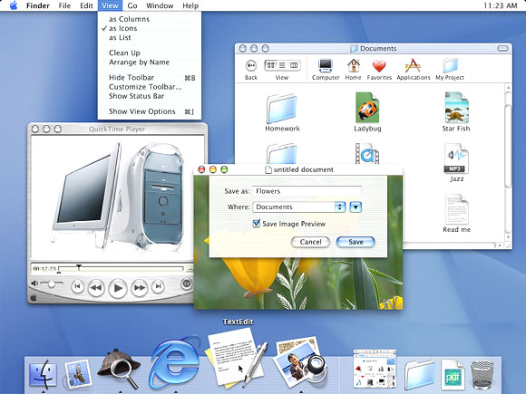
Reduce
Short Term Memory Load
Minimize the Users Memory Load
  Rule of Thumb:
  Humans can remember 7± chunks of information at a time
Keep displays simple
7 or fewer menu/toolbar options
Notes:
Minimize the user's memory load
by making objects, actions, and options visible.
The user should not have to remember information from one part of the dialogue to another.
Use instructions in blackboard; do not use worksheet.

