Slide 1
What is MIS
IT vs IS
View the world as a system

Slide 2
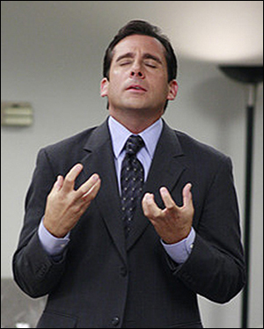
Management Information Systems (MIS)
What does this term really mean?
Management
  a major at Siena,
  a good occupation.
  the act of managing;
  handling, directing, controlling.
A well-known
manager on TV

Slide 3
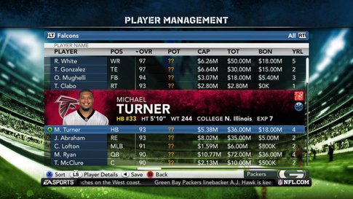
MIS applies to many fields
More than just Information Systems used by Managers?
The study of systems that enable/facilitate
the management of information
The information
could be for
  Accounting
  Finance
  Marketing
  Scientific Research
  Computer Gaming
Madden Football Player Management

Slide 4
MIS helps build understanding
We have studied how MIS transforms data into information and then beyond
Correctness
Wisdom
People
Understanding
and developing principles and concepts
Knowledge
Computers and Systems
Understanding patterns
Information
Adding value, context, relationships, and patterns
Data
Understanding

Slide 5
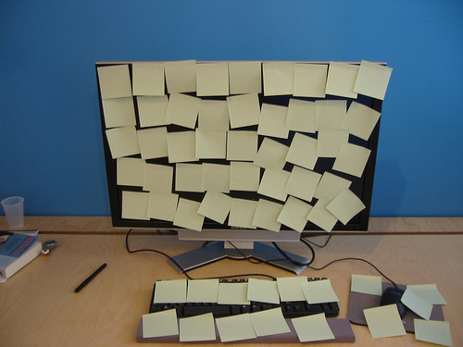
A better course title for MIS
I would call this course…
How Computer Systems help you Manage Information
Computer being used to manage information poorly.

Slide 6
INFORMATION TECHNOLOGY
VS.
INFORMATION SYSTEMS
Innovations in storing, transmitting, and sharing information
hardware devices like:
  Telephone
  Computer Printer
  Wireless Network Router
Also includes software, languages, and protocols:
  Photoshop, Java, Flash, HTML, HTTP, etc.
1. Computer hardware and
2. Software,
but also includes:
3. People
4. Processes, and
5. Data
Familiar Information Systems
  Twitter
  iTunes
  Blackboard

Slide 7



Software is always part of bigger systems
Consider these examples
Twitter
  Pointless without people?
iTunes
  Little value without data (music, movies, etc.)
Blackboard
  Useless without procedures

Slide 8
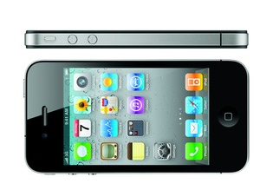
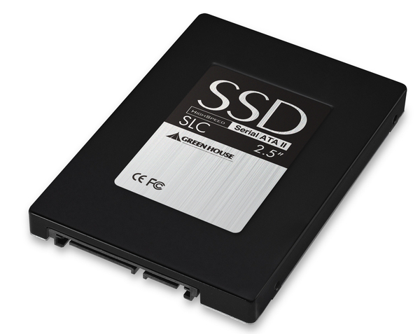
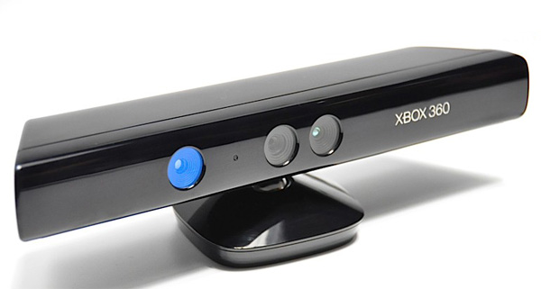
Hardware is always part of bigger systems
Consider these examples
iPhone
  Pointless without people
Solid State Hard Drive
  No value without data (files, movies, etc.)
Xbox Kinect
  Difficult to use without procedures

Slide 9
Information Technology is part of
Information Systems
IS
IT
People
users, administrators, owners, etc.
Hardware
PC, iPad, Android Phone,
RFID Scanner, Laser Printer, etc.
Data
numbers, words, images, video, etc;
computerized (digital) or on paper
Software
Excel, Access, Blackboard, iTunes
Chrome, Windows 7, Oracle
Procedures
often documented in writing

Slide 10

IT is practically free
Cost of labor and natural resources keep rising.
But, every 18 months, the cost of information technology decreases by nearly 50%
  See Figure 1-1 in the book
Data communication and storage are so cheap that CEO’s consider it free.
  Businesses leverage this “almost” free commodity.
  And, consumers are happy to pay for it.

Slide 11

Leveraging Technology
In 1992, I bought Metallica’s
Black Album for $16.99
at store called Record Town.
Today, you can download new albums on iTunes for $9.99.
  Information Technology makes delivering music cheaper
    right or wrong?
  This is great for the consumer
    right or wrong?

Slide 12
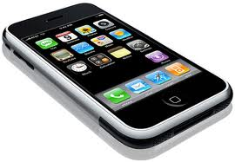
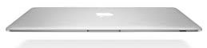
How Leveraging Technology Works
Those who purchase “cheap” songs on iTunes often
  Pay $60-$100/month for their phone data service
  Pay $800-3000 every 3-5 years for laptop

Slide 13
How Leveraging Technology Works
Consumers pay for Apple’s store (iTunes) by buying Apple hardware
Apple Corporation can sell music without
  moving stuff in trucks
  building a store in your town
  hiring clerks
BTW: Microsoft leverages consumers in similar ways.

Slide 14
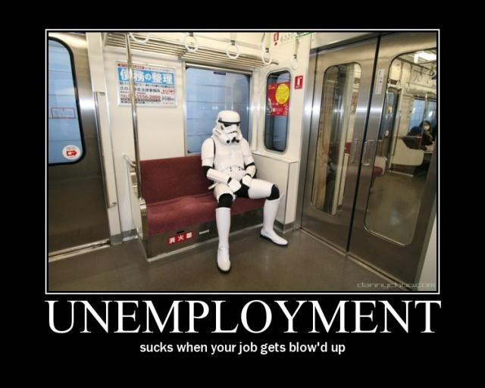
Why I care?
I teach Computer Science (CS)
majors how to
blow up your business job!
In CS, we build software systems that replace costly human labor to help businesses become more profitable
  unless you have ideas on how to use information systems to improve business, you might not have a “thinking” career in business.

Slide 15

How this course really helps?
By making you do lab activities where you will
Use computer systems to solve problems and manage information
Labs are important because
  You get to actually do stuff
  Then, you think about what you did
  Then, I tell you why it was important
What lab might look like if I were handsome and smiled

Slide 16
Will doing the labs make me a master of technology?
No!
You have to do 4 other things
But, these things will also help you
  get an A in the course and
  avoid a grunt-like career with no job security
Do you want to know the 5 things?

Slide 17
#1 Look at the world as a system
1. Goal
2. Observe
Input
Output
3. Action
Identify goals
Make honest observations about the world around you, and connect inputs with outputs
Take action to achieve your goal

Slide 18
#1 Look at the world as a system
Input
Output
Connect input and outputs
Goal: I want to get an A.
Observations:
  Studied 2 hours for exam1 and got a B.
  Studied 4 hours for exam2 and got a A-.
Input: hours studied
Output: grade
Why this helps
Some systems are poorly designed and unfair, some are fair and consistent.
Regardless, understanding how a system works is the key to controlling the system and achieving goals.

Slide 19

#2 Share ideas and be open to criticism
McDonald’s Grunt:
Goal: To be a manager
Observation: We cook too many fries at once. By the time we sell them all, the last order is cold.
Idea: We should cook half as many fries, but twice as often.
Idiot Night Manager:
Criticism: Dude, we are going to have to work harder to fill the fryer twice as often.
Grunt:
Openness: You are right, but my goal is to make crispy, tasty fries and I’m not afraid to work harder.

Slide 20
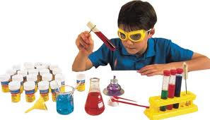
#3 Experiment
(test what works the best)
Grunt:
  Filling the fryer at 50% capacity but twice as often is too much work.
  but filling it at 66% capacity but 1.5 times as often works out great
  Also we can change the % based on how busy we are.
Idiot Night Manager:
  Good job, nerd!
District Manager:
  Since we hired Grunt, we are selling more fries
  customers say the fries are fresher and crispier
Outcome:
  Grunt gets promoted to “thinking” position
  Idiot Manager has to follow Grunt’s nerdy fry cooking process any way.

Slide 21
#4 Identify bad ideas and do the right thing.
Student #1 goal
  My goal is to minimize the amount of work to do on this project.
Student #1 idea
  I will just copy text from Wikipedia.
Student #2 identifies bad idea
  That’s plagiarism and it might lead to you having to do more work.
Outcome:
Student #1 gets
  a zero on project,
  fails the course
  must take the course again
  must redo project next semester anyway
Student #2 ends up doing a lot less work on the project than student #1.

Slide 22
Components of an Information System
Actors
Instructions
Bridge
Hardware
Software
Data
Procedures
People
Computer Side
Human Side
Automation: Move work from human side to computer side
More difficult to change

Slide 23
Components of an Information System
The benefits of automation is not just to do things automatically.
What are the real benefits of automation?
Automation: Move work from human side to computer side
More difficult to change
Hardware
Software
Data
Procedures
People
Computer Side
Human Side

Slide 24
2 big benefits of IS automation
Agility
Growth
People are often
  slow to change
    Often hard to retrain
Replacing people with computers (hardware) helps businesses become more agile.
  Business processes can be changed easier if they are implemented with hardware or software.
Procedures are often
  ambiguous
    not formally defined
  tedious
    difficult to follow
Replacing procedures with programs (software) helps business to grow
  Business processes can be scaled up easier if they are implemented with software or hardware.

Slide 25
iTunes as a System
Hardware
Software
Data
Procedures
People
Examples?
Examples?
Examples?
Examples?
Examples?

Slide 26
iTunes as a System
Hardware
Software
Data
Procedures
People
User devices:
iPhone
iPod
iPad
MacBook
MP3 Player
PC
Apple side:
Media Server
Infrastructure:
Network
Routers
User devices:
iTunes itself
Mac OS
Apple side:
Media Content Management System
Media itself
Music
Movies
TV Shows
Apps
Games
User:
Create account
Login
Buy song
Apple Side:
Add new song
Organize songs
Advertise new
songs
Content Providers:
Upload song
Get money
User:
Consumer who buys songs,
Apple :
System admins
Programmers
CSR
Marketers
Content Providers:
Artists, Record Studios, App Developers, Colleges

Slide 27
Blackboard as a System
Hardware
Software
Data
Procedures
People
Examples?
Examples?
Examples?
Examples?
Examples?

Slide 28
Blackboard as a System
Hardware
Software
Data
Procedures
People
User devices:
PC
Laptop
Admin side:
Web Server
Database Server
Infrastructure:
Network
Routers
User devices:
Web Browser
Excel
Admin side:
Blackboard system itself
Database tools
Student Grades
PowerPoint files
Word Documents
Assignments
Project Descriptions
Messages
Calendar items
Student:
Login
Submit assignment
Check grades
Faculty:
Enter grades
Upload project description
Admin side:
Create courses
Enroll students
Students
Faculty
System Admins

Slide 29
General
System View
Information System View
VS.
Concrete & Real
(i.e., not abstract)
5 components:
Hardware
Software
Data (bridge/center)
Procedures
People
Conceptual View (i.e., abstract)
8 properties:
Stakeholder
Goal
System Boundaries
Input
Processing
Output
Feedback
  key in understanding systems
Control

Slide 30
iTunes
Stakeholder
Goal
Input
Processing
Output
Customer
Musician/
Artist

Slide 31
iTunes
Stakeholder
Goal
Input
Processing
Output
Customer
wants to buy a cheap song
Song selection, credit card number
(money)
Check to see if card is valid,
Start download of song
Decoded audio file, can be copied on up to 8 devices
(song)
Musician/
Artist
Wants to sell their music
Artist account information, encoded audio file
(song)
Create artist account, song added to system
Electronic funds added to account for each song sold (money)

Slide 32
iTunes: Customer Feedback
Stakeholder
Goal
Input
Processing
Output
Customer
wants to buy a cheap song
Song selection, credit card number
(money)
Check to see if card is valid,
Start download of song
Decoded audio file, can be copied on up to 8 devices
(song)
Examples of Feedback:
Message: “Lagy Gada not found, did you mean Lady Gaga.”
Message: “you have $4.99 left on your gift card.”
Message: “this song is authorized on 5 devices.”
Message: “5 minutes left to download song.”

Slide 33
Feedback from a user/customer perspective
Messages that let you know what is happening
Information about your usage of the system
  Is your input good?
  Is your output on the way?
Helps you
  correct mistakes
  enter input
  understand the output

Slide 34
iTunes: Artist (content provider) Feedback
Stakeholder
Goal
Input
Processing
Output
Musician/
Artist
Wants to sell their music
Artist account information, encoded audio file
(song)
Create artist account, song added to system
Electronic funds added to account for each song sold
(money)
Examples of Feedback:
Message: “Your song X has been purchased 74 times.”
Message: “County is not a valid category for song X.”
Message: “You have not uploaded an image for your band.”
Message: “5 minutes left to upload song Y.”

Slide 35
Key Concept: Feedback is relative to the stakeholder/goal.
Notice how similar the feedback is for customers and artists.
Why?
They are both the same kind of stakeholder.
  Both users of iTunes.
  Symmetric goals
    Buy song
    Sell song
But, iTunes has another stakeholder! Who?

Slide 36
iTunes: System Owners perspective
Stakeholder
Goal
Input
Processing
Output
Apple Corporation
Sell media (music, apps, movies, etc.)
Provide content to add value to iPhone, iPads, etc.
New features
New types of media
Create new user accounts
Add new media
Promote media
Increased
usage, exposure, market share
Increased
sales (money)
Examples of Feedback:
Top selling songs, shows, apps, etc.
Login/usage report including top devices used (i.e., iPhone, iPod Touch, iPad, MacBook, PC, etc.)
Sales by media type (music, movies, etc.)

Slide 37
Feedback from the system owner’s perspective
Messages that tell you
  if the system is working
  how well it’s working
  how close you are to achieving a goal
Apple did NOT create iTunes to generate a sales report?
The sales report is feedback, not output.

Slide 38
System Boundaries & Data Flow
1. Goal: Make a profit off the selling of music
2. Stakeholder: Apple Corp.
3. Information System Boundaries
8. Control:
New Features
People:
Customers
Musicians
Hardware:
Media Server
User devices
7. Feedback:
Usage Reports
Software:
iTunes
Data:
Songs
Account Info
Procedures:
Buy song
Sell song
4. Input:
More musicians
5. Processing: Charge customers, distribute songs, organize musicians, promote
6. Output:
Electronic Funds

Slide 39
Lady Gaga Perspective
1. Goal: Sell my music
2. Stakeholder: Lady Gaga
3. Information System Boundaries
8. Control:
promote new song
People:
Customers
Admin
Hardware:
Media Server
User devices
7. Feedback:
Top Selling Songs
Software:
iTunes
Data:
Songs
Account Info
Procedures:
Categorize
song
4. Input:
New songs
5. Processing: Charge customers, distribute songs, promote
6. Output:
Electronic Funds

Slide 40
Dissatisfied Customer Perspective
1. Goal: Buy my favorite music
2. Stakeholder: iTunes Customer
3. Information System Boundaries
8. Control:
Pick a new song
Or stop using iTunes
7. Feedback:
“AC/DC not found”
People:
Admin
Musician
Hardware:
Media Server
User devices
Software:
iTunes
Data:
Songs
Account Info
Procedures:
Create new
account
4. Input:
Song Selection
5. Processing: Charge customers, distribute songs, promote
6. Output:
A digital song

Slide 41
Satisfied Customer Perspective
1. Goal: Buy my favorite music
2. Stakeholder: iTunes Customer
8. Control:
Buy an iPod so I can enjoy Buckethead on the go
3. Information System Boundaries
7. Feedback:
“Buckethead album on sale”
People:
Admin
Buckethead
Hardware:
Media Server
User devices
Software:
iTunes
Data:
Songs
Account Info
Procedures:
Create new
account
4. Input:
Credit Card #
Song Selection
5. Processing: Charge customers, distribute songs, promote
6. Output:
A digital song

Slide 42
Key Concept: Feedback is not output
“you have $4.99 left on your gift card.”
  Consumers do NOT login to iTunes to find out how much money they have left on a gift card.
  The goal is to get and listen to music
“County is not a valid category for your song.”
  Artists do NOT login to iTunes to figure out how to spell “Country.”
  These messages are forms of feedback, not output!

Slide 43
Feedback
Output
VS.
All feedback is a form of output because it comes out of the system
But, feedback is specific output that
helps stakeholders use a system
tells owners if a system is working
is more directly connected to the goal or purpose of a system.
If you want to buy a song from a system, the output is the song.
What if the goal of a system is to generate a sales report?

Slide 44
Great Examples
Cash Register System
Facebook
Goal: In the 1980’s McDonalds wanted to track sales in real time so they invest in a computerized cash register system. Real time sales reporting will help them improve their supply chain.
Sales Report
Output or feedback?
Goal: In 2008, McDonalds wanted to use social networking to distribute coupons to better promote its new menu items. Hopefully sales for the new items will improve once the coupons are on Facebook?
Sales Report
Output or feedback?

Slide 45
Great Examples
Blackboard
Blackboard
Goal: Professor wants to share grades with students.
Problem: Students keep asking for their grades in class
Investigation: Professor notices that students have never logged in.
Solution: Professor shows students how to login.
Student Login Report
Output or feedback?
Goal: Professor wants to track if students are clicking on the assigned case studies
Input: Case Studies (Word Documents)
Processing: Students login, navigate to case studies, click on document, Blackboard tracks the clicks.
Student Click Report
Output or feedback?

Slide 46
Input vs. Control
Input is what you put into the system.
  It is typically processed in some way to produce output.
    You input fuel into a car and the car produces forward movement
    From Apple’s perspective, you put musicians and customers in iTunes and money comes out.
  Input is usually a noun: Fuel, a song, a grade, money, raw data, potatoes, a musician.
Control is how you might change the system
  Control is usually a verb.

Slide 47
Examples of System Control
Deep Fat Fryer: Raise the cooking temperature
Facebook: Restrict wall posting to only close friends
Blackboard: Show only my active courses
Assembly Line: Increase production by 20%
iTunes: Block artists from uploading Microsoft file formats
Furnace: Limit the output to 71 degrees

Slide 48
System Control
Systems have variables that can be changed
  And parameters that cannot be change
Variable:
  Assembly line can be set to output between 0 and 20 cars per minute
  Output is set to 10
Parameter:
  20 cars per minute is the maximum

Slide 49
Critical Thinking Question
Setting the thermostat to 68 degrees
Is this an example of input, output, processing, control or feedback.

Slide 50
Analysis Technique
Setting the thermostat to 68 degrees
First ask two questions:
  Who is the stakeholder?
  What is their goal?

Slide 51
Analysis Technique
Setting the thermostat to 68 degrees
  Who is the stakeholder?
  Me
  What is their goal?
  To keep the room temperature at 68 degrees

Slide 52
Analysis Technique
Setting the thermostat to 68 degrees
  “setting” is a verb
  Could be processing or control
Control can change/invoke processing but may not produce output.
Processing directly leads to output.
  What if there is no fuel?
  What if the temp is already 68 degrees?
  “Burning fuel” is the process
  “Heat” is the output.

Slide 53
Analysis Technique
Setting the thermostat to 68 degrees
  “68 degrees” is a noun, a number, a temp value
  Could be input, output, or feedback.
Are you putting this value into the system our does the system spit out this number?
Does this tell you if the system is meeting the goal?

Slide 54
Processes vs. Transactions
Are transactions a type of business process or are processes a type of business transaction?
Do transactions involve processing?
Do processes involve transactions?
Confused?

Slide 55
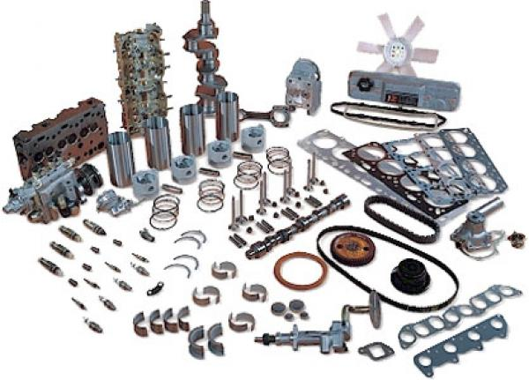
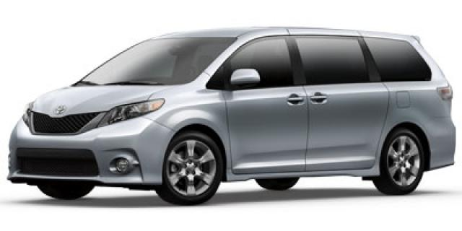
Example of a Business Process
Toyota manufactures a Sienna Minivan

Slide 56
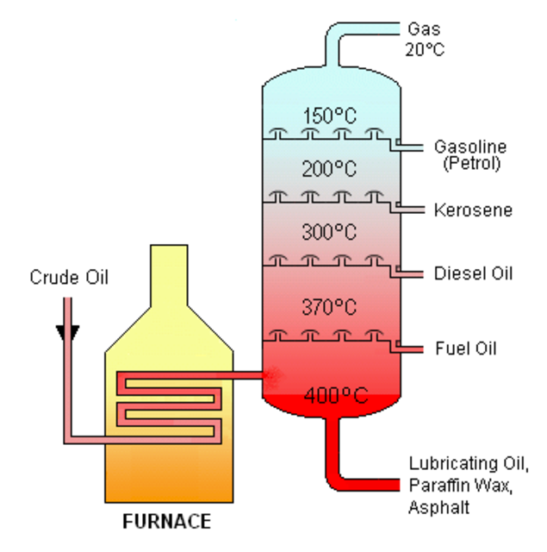
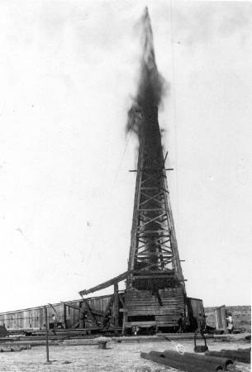
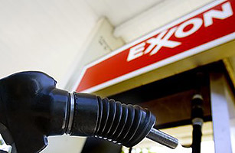
Example of a Business Process
Exxon-Mobile refines crude oil into gasoline

Slide 57
Process Control Systems (PCS)
PCS’s help to
  control processes (duh!)
  automate processes
  speed up processes
  make processes more cost effective
  generate feedback to better understand processes

Slide 58
Business Processes involving Computers and Information
Siena College registers students for classes
Times Union Center checks tickets at door
Doctor’s Office schedules patient visit

Slide 59
The transaction component of information processing
Siena College bills a student for classes
Times Union Center sells tickets to customers
Doctor’s Office cashes check from patient

Slide 60
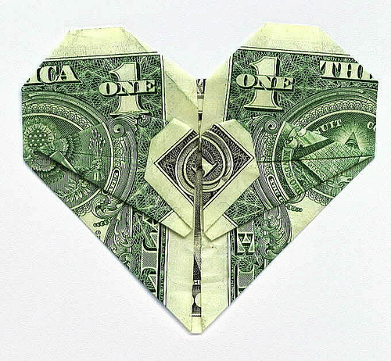
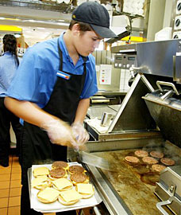
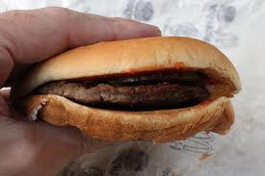
Process vs. Transaction
McDonald’s “makes” a hamburger
McDonald’s takes customer’s money and gives customer a hamburger.

Slide 61
Process vs. Transaction
A Process
A Transaction
The steps involved in
  transforming raw materials into a product
  providing a service
    FYI: taking a customer’s money is not a service
Information Processing: Transforming Raw Data into useful Information
Usually involves two entities
  customer and business
  (or C2C, B2B, etc)
Things of value are exchanged
  money for a product
  money for a service

Slide 62
Process vs. Transaction
While a transaction is part of a bigger business process, the transaction does not produce the product or service
  Example: Handing a cashier money does NOT produce a hamburger.
  What are the key processes in making a hamburger?

Slide 63
Process or transaction?
Customer use a credit card to buy their 40 year old brother a $120 StarWars light-saber from Amazon.com.

Slide 64
Process or transaction?
Placing 10 lbs of sliced potatoes into a deep-fat fryer in order to cook French fries.

Slide 65
Process or transaction?
Time Warner mails a customer a cable TV bill

Slide 66
Process or transaction?
Toyota printing 1000 payroll checks for the assembly line workers at a plant in Ohio.

Slide 67
Process or transaction?
Siena department heads
  develop a schedule of classes and
  assign professors to teach the classes.
Students register for classes.
These processes were hell before information systems could help

Slide 68
Process Control Systems (PCS)
Information Systems that help control processes, not transactions.
Is a cash register a PCS?

Slide 69
What is a cash register these days?
Functionality/Capabilities
  Store money in a drawer
  Swipe/read a credit card
  Connect to VISA/MC/AE
  Scan a product’s bar code to get price
  Calculate the amount of change
These capabilities
  Have nothing to do with making products or services
  Have everything to do with transaction of the product.

Slide 70
PCS + TPS + MIS is common
IBM sells McDonalds a system which combines a
  Cash Register System (example of TPS) with an
  Order Processing System (example of PCS).
Together the TPS and PCS send data to a
  Supply Chain Management System
  (example of MIS)
    helps McDonalds streamline its distribution of raw materials (buns, burgers, potatoes).

Slide 71
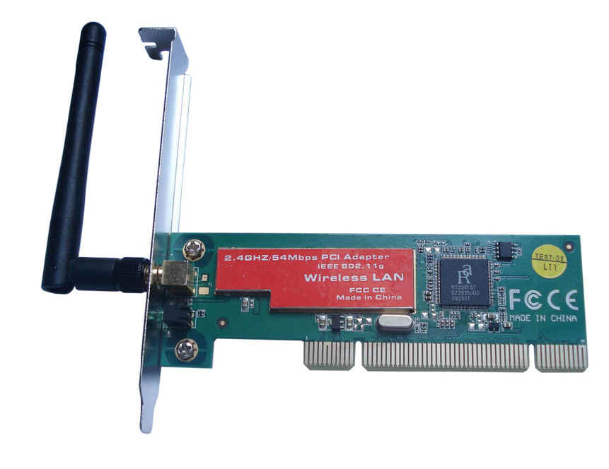
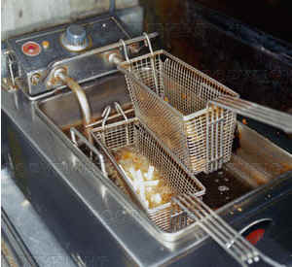
Critical Thinking Question
Observation: The new deep fat fryer at McDonalds has a wireless network adapter.
Question: Is this the stupidest thing you’ve ever heard of or what?
Real Question: Why would you ever connect a deep fat frying to the Internet?

Slide 72
Deep Fat Fryer as a Hardware Device
Goals: Fresher fries, less waste
Fryer as PCS Data Source
  Amount of Fries cooked is input to other systems
    Helps you determine when to change the fryer oil more consistently
    Compare to fries sold (from TPS) and you get feedback
      If fries sold << fries cooked then we are cooking too many fries.
Fryer as a processing control device
  Fryer tells you exactly how far to fill it.
  Instead of cooking fries on demand, you always cook fries, but vary the “load” based on historical sales (from TPS).

Slide 73
Control vs. Processing revisited
Comparing fries cooked to fries sold to calculate % waste is information processing
  Cooking the fries is physical processing, not information processing.
% waste is feedback
  Not necessary to cook fries but indicates if you are meeting your goal.
Looking at yesterdays data might not be enough to make good estimates.
Changing the system so it looks at the average for all weekdays is information system control.
Computing this average is information processing.

Slide 74
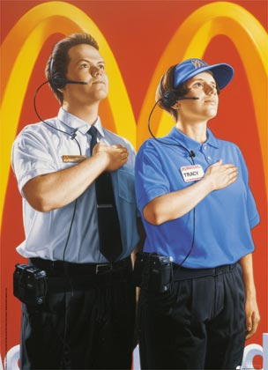
Human Reaction
Imagine if you’ve been working at McDonalds for 10 years and now a device tells you exactly how many pounds of potatoes to put in the fryer.
How might you react?
  How should you react?

Slide 75
Types of Information Systems
Information Systems evolved over time.
History
Where are we now.

Slide 76
Studying Systems
Large companies had so many information systems that you could actually study them like animals.
Mammals, Birds, Reptiles, Fish, etc.
  Different families
    Different species
This is called a taxonomy
  helps you understand similarity and difference
Information Systems also have a taxonomy.

Slide 77
Taxonomy of Systems
Large companies had so many information systems that you could actually study them like animals.
Mammals, Birds, Reptiles, Fish, etc.
  Different families
    Different species
This is called a taxonomy and it helps you better understand the similarity and difference between animals.
Information Systems also have a taxonomy.

Slide 78
Classic Taxonomy of
Information Systems
All Information Systems
Operational Systems:
Systems that Support Operations
Management Systems:
Systems that Support Management
DSS
Decision
Support
Systems
EIS
Executive
Information
Systems
ECS
Enterprise
Collaboration
Systems
MIS
Management
Information
Systems
TPS
Transaction Processing
Systems
PCS
Process
Control
Systems

Slide 79
Transaction Processing System (TPS)
0
Helps to manage transactions
  ATM Machine System
    Banking Transactions
  Cash Register System
    Point of Sale Transactions
  Accounting System – Checking Account Transactions
  Even Pay-per-view or OnDemand is a TPS

Slide 80
Process Control Systems (PCS)
0
Monitors and Controls Production Processes
  Often Industrial/Manufacturing Processes
Examples:
  Petroleum Refining
  Power Generation
  Automobile Manufacturing
  Making French Fries

Slide 81
Enterprise Collaboration Systems (ECS)
Companies had many independent systems in different departments
  Email (Outlook Express)
  Scheduling (r25 system)
  Video & Teleconferencing (Cisco system)
Companies now strive to have one unified system
  Outlook (email, scheduling, task management)
  Slack
  Google Apps

Slide 82
Enterprise Collaboration Systems (ECS)
0
Supports Operations (Surprised?)
Teamwork, communication, and collaboration
Examples:
  E-mail
  Chat
  Video Conferencing
  Calendaring
  Journaling
  Workflow
  File Sharing

Slide 83
Management Information System (MIS)
0
Supports Management (duh?)
Analysis & Reporting
  Charts, Graphs, Summary Tools
Usually connected to TPS and PCS systems.
Examples:
  Banner – Manages College Information (Siena uses it)
  Spreadsheet (Excel) – One of the first and most basic
    Now considered a tool that is part of a system
  Oracle's Corporate Performance Management

Slide 84
Decision Support System (DSS)
0
What-if Analysis, Decision Modeling, Scenario Building, Highly interactive, ad hoc.
Most DSS’s are custom developed for specific companies; very few out-of-the-box products.
One Example:
  Enterprise Decision Manager 2.0 Fair Isaac Corporation

Slide 85
Executive Information Systems (EIS)
0
Supports high-level strategic management
Uses critical data from other systems (MIS and DSS).
Portal Concept: one place with links to all information
EIS’s integrate external information such as economic developments and news about related markets and competitors. Helps strategic decision making, not just tactical.
  Tactical – doing things the right way right
  Strategic – doing the right things

Slide 86
Information Flow
0
Executives
Enterprise Collaboration System
Executive Information System
System
Information
Flow
Managers
DSS
MIS
Information
Exchange/
Communication
TPS
PCS
Operational Systems and Staff

Slide 87
Information Flow
0
Executives
Enterprise Collaboration System
Management
Executive Information System
Managers
DSS
MIS
Operations
TPS
PCS
Operational Systems and Staff

Slide 88
Information Systems support all levels of a business’s hierarchy
Strategic
Decision Making
Executive Level
Tactical Decision Making
Management Level
Business Processes
Operations Level

Slide 89
Information Systems
Support all types of employees
CEO
President
Strategic
Decision Making
Executive Level
VP Finance
Research
Director
District Manager
Tactical Decision Making
Management Level
Dean
Production Manager
Designer
Night Manager
Account Supervisor
Graphic Artist
Teacher
Business Processes
Operations Level
Assembly Line Worker
Cashier

Slide 90
Computer
Information Systems first supported the
Management Level
Early 1980’s
Strategic
Decision Making
Executive Level
Paper Reports
Spreadsheet Program
Data Import
Store Information in Computer Files instead of Paper Files
Raw Data Entry
Business Processes
Operations Level

Slide 91
Management demanded specialize systems and pushed data entry to
Operational Level
Late 80’s
Strategic
Decision Making
Executive Level
Paper Reports
Accounting Information System
Electronic
Reports
Raw Data Entry
Data Entry System

Slide 92
Each manager wanted their own custom system for their
Functional Area
Late 1980’s
to early 90’s
Strategic
Decision Making
Executive Level
Financial Information System
Accounting Information System
Production Information System
Account Data Entry System
Finance
Data Entry System
Inventory Data Entry System
Assembly Line
Control System

Slide 93
Executives wanted integrated, real-time information
(no more paper reports)
Mid 1990’s
Executive
Information System
Financial Information System
Accounting Information System
Production Information System
Account Data Entry System
Finance
Data Entry System
Inventory Data Entry System
Assembly Line
Control System

Slide 94
Large companies replaced many “functional systems” with one large “enterprise system”
Late 90’s and
2000’s
Executive
Portal
Enterprise
System
(central database)
Financial Reports
HR
Reports
Accounting
Reports
Marketing
Reports
Production Reports
Data Entry Framework
Finance
Accounting
Operations & Production
Marketing
HR

Slide 95
Functional Systems
In in the early 1990’s, Information Systems were focused on the narrow needs of specific Functional Areas
  Accounting – Inventory Control
  Finance – Investment Reporting
  Operations - Production Control
  Human Resources – Benefit Management
  Marketing – Sales Management

Slide 96
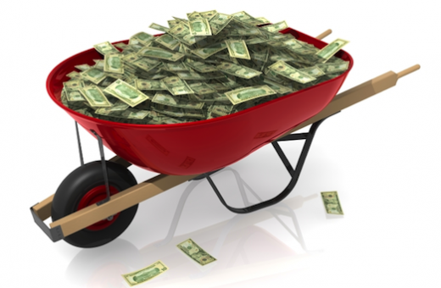
Enterprise Systems
Executives notice that
  fast, accurate information gave their company a strategic advantage.
Money was being spent
on very similar systems
for each Functional Area
Could Accounting and Finance
use the same system?
  Could all the systems be integrated?

Slide 97
Functional vs. Enterprise
Functional
  Tailored to the goals of one functional business unit (Accounting, Marketing, HR, etc.)
Cross-functional
  Tailored to two or more functional business units, but not all.
Enterprise
  Tailored to the goals of the entire company; typically used by all units

Slide 98
Another Taxonomy
All Information Systems
Cross-Functional
Systems:
Two or more area, but not all
Enterprise
Systems:
Integrates all
functional areas
Functional
Systems:
Focused on one
functional area
ECS
Enterprise
Collaboration
Systems
EIS
Executive
Information
Systems
MIS
Management
Information
Systems
TPS
Transaction Processing
Systems
DSS
Decision
Support
Systems
PCS
Process
Control
Systems

Slide 99
Scope of Information Systems
Personal:
  Used by one person
  Duplication of data among employees
  Example: Using Excel to make a report
Work Group:
  10-100 Users
  Duplication among departments
  Example: Google Sheet used to tally work hours

Slide 100
Scope of Information Systems
Enterprise:
  Used by entire business
  Truly central database
  Example: Web for Student and Web for Faculty are all part of Banner (Siena’s ERP)
Inter-enterprise:
  Used by many businesses that collaborate
  Very difficult to implement
  Example: Walmart requiring suppliers to use their Supply Chain System

Slide 101
Functional → Enterprise
How quickly can HR hire new employees to deal with sudden spike in orders?
Accounting
Payment Data from customer
Budgeting data
Marketing
Order Data from customers
Sales forecasting Data
Human Resources
Employee recruiting & training
HR Planning

Slide 102
Examples of Enterprise Systems
Customer Relationship Management (CRM)
Marketing System that have evolved to integrate Accounting, Finance and even manufacturing
Goal is Sales and Marketing Automation
Some would argue CRM is cross-functional and not truly Enterprise
Examples
  Salesforce
  SAP
  Oracle
  Microsoft Dynamics
Enterprise Resource Planning (ERP)
The true Enterprise System
Combines
  Purchasing materials
  Materials management
  Production & manufacturing
  Distribution & Sales
  Customer Relationship Management
  Financial & Long-term planning

Slide 103
Summary
Information Systems include IT (Hardware and Software) but also People, Data, and Procedures to follow.
Understanding General System requires identifying 8 key components: Goals, Stakeholders, System Boundaries, Input, Processing, Output, Feedback, and Control.

Slide 104
Summary
Historically, system have been designed for the 5 core functional units of business.
6 different types of systems emerged: PCS, TPS, ECS, MIS, DSS, and EIS.
More recently, enterprise systems have been developed to integrate systems in all the units.

