Slide 1
Business Intelligence Systems (Decision Support Systems)
Chapter 9

Slide 2
Type of Business Intelligence Tasks
Project Management
  CMCC helping folks to collaborate
Problem Solving
  How can we reach a goal? Ideas. People component
Deciding
  What should we do exactly
  Which layoff scenario is the “best”
Informing
  Reporting reality (accurate, complete, timely)
  Which conference room is most profitable

Slide 3
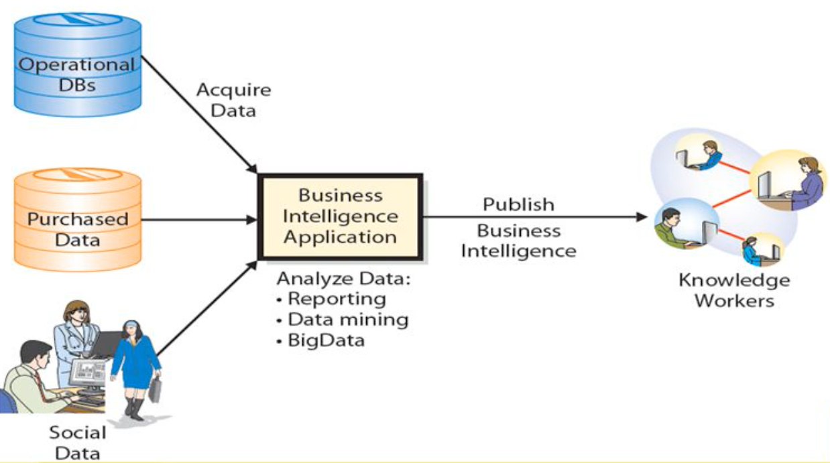
Components of a Business Intelligence Application
Expert Knowledge

Slide 4
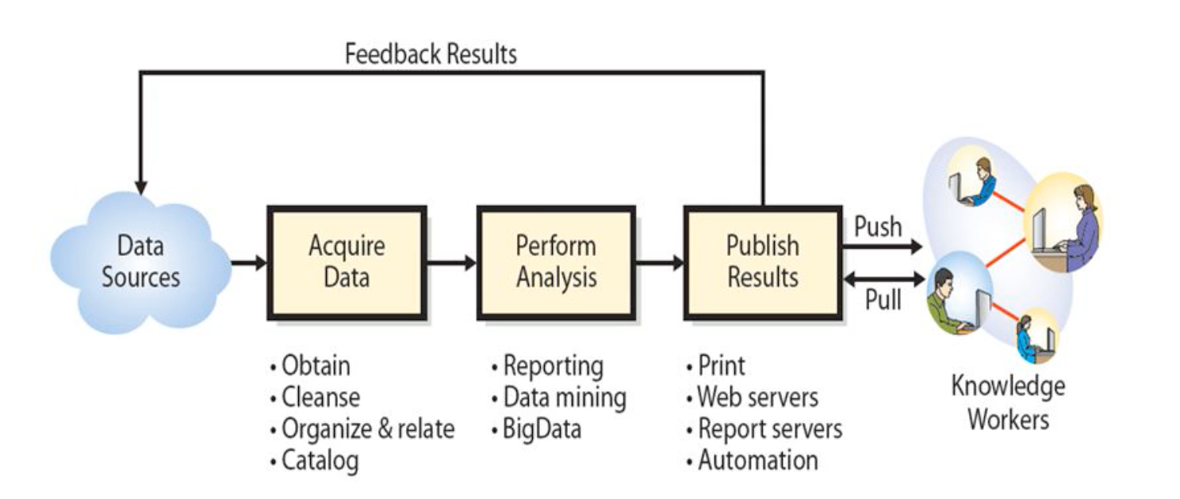
Activities in Business Intelligence Process

Slide 5
Putting it all together
Information Systems 5 Components
  People
  Processes
  Data
  Software
  Hardware
System Components
  Input
  Output
  Processing
  Feedback
Attributes (Data →) Information
  Accurate
  Complete
  Simple
  Timely
  Relevant
  Verifiable
  Secure
  Accessible
  Economical
  Flexible
  Reliable

