Slide 1
What is MIS
IT vs IS
View the world as a system

Slide 2
Management Information Systems (MIS)
What does this term really mean?
Management
a major at Siena,
a good occupation.
the act of managing; handling, directing, controlling.
A well-known manager on TV

Slide 3
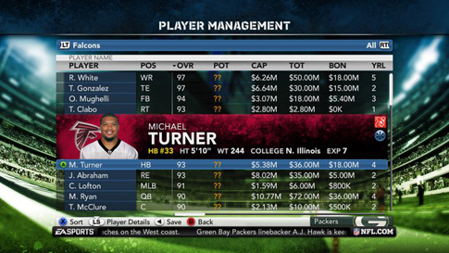
MIS applies to many fields
More than just Information Systems used by Managers?
The study of systems that enable/facilitate the management of information
The information could be for
Accounting
Finance
Marketing
Scientific Research
Computer Gaming
Madden Football Player Management

Slide 4
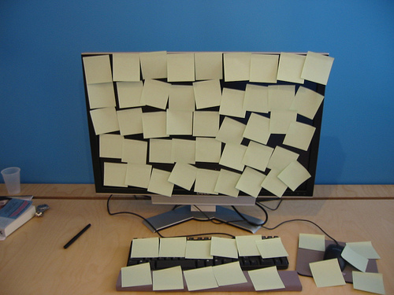
A better course title for MIS
I would call this course… How Computer Systems help you Manage Information
Computer being used to manage information poorly.

Slide 5
INFORMATION TECHNOLOGY
VS.
INFORMATION SYSTEMS
Innovations in storing, transmitting, and sharing information
hardware devices like:
Telephone
Computer Printer
Wireless Network Router
Also includes software, languages, and protocols:
Photoshop, Java, Flash, HTML, HTTP, etc.
1. Computer hardware and 2. Software,
but also includes:
3. People
4. Processes, and
5. Data
Familiar Information Systems
Instagram
Web for Students (Siena)
Canvas

Slide 6
Software is always part of bigger systems
Consider these examples
Instagram
Pointless without people
Web for Students
Little value without data (class schedules, rosters, etc.)
Canvas
Useless without procedures

Slide 7
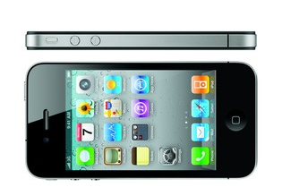
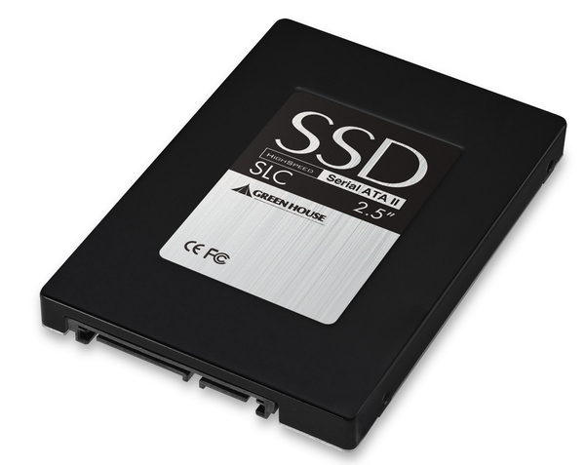
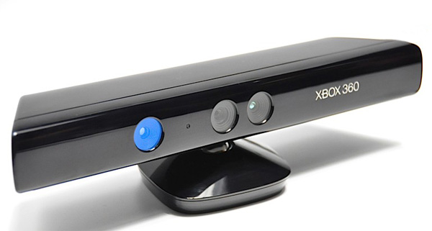
Hardware is always part of bigger systems
Consider these examples
iPhone
Less value without people
Solid State Hard Drive
No value without data (files, movies, etc.)
Xbox Kinect
Difficult to use without procedures

Slide 8
Information Technology is part of Information Systems
IS
IT
People users, administrators, owners, etc.
Hardware PC, iPad, Android Phone, RFID Scanner, Laser Printer, etc.
Data numbers, words, images, video, etc; computerized (digital) or on paper
Software Excel, Access, Blackboard, iTunes Chrome, Windows 7, Oracle
Procedures often documented in writing

Slide 9
IT is practically free
Cost of labor and natural resources keep rising.
But, the cost of information technology keeps decreasing
See Figure 1-1 in the book
Data communication and storage are so cheap that CEO’s consider it almost free.
Businesses leverage this “almost” free commodity.
But, in reality consumers are paying for much of it.

Slide 10
Leveraging Technology
In 1992, I bought Metallica’s Black Album for $16.99 at store called Record Town.
Today, you can download new albums on iTunes for $9.99.
Information Technology makes delivering music cheaper
right or wrong?
This is great for the consumer
right or wrong?

Slide 11
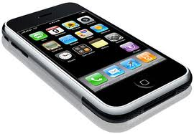
How Leveraging Technology Works
Those who purchase “cheap” songs digitally
Pay $30-$100/month for their phone + data service
Spotify premium is $10/month, but you might be listening to music on a laptop that cost $2000 while using a Internet connection that cost $120/month
How much is Spotify really costing you?

Slide 12
How Leveraging Technology Works
Consumers pay for Apple’s store (App Store & iTunes) by buying hardware
Apple Corporation can sell music without
moving stuff in trucks
building a store in your town
hiring clerks
BTW: Other companies leverage consumers in similar ways, i.e., you are paying for “the store” in your pocket.

Slide 13
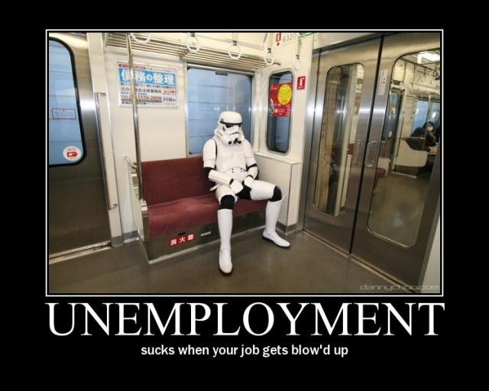
Why I care?
I teach Computer Science (CS) majors how to blow up your business job!
In CS, we build software systems that replace costly human labor to help businesses become more efficient/profitable
unless you have ideas on how to use information systems to improve business, you might not have a “thinking” career in business.

Slide 14
Fired?
Read the story on pages 3 and 4
Jennifer got fired
Did not demonstrate non-routine skills.
Part of MIS: How to replace routine human labor with computer-based automation.
Not just about eliminating jobs and costs (efficiency), it is actually more about allowing humans to focus on thinking-work, rather than routine tasks.

Slide 15
New Jobs
Computers do certain things better than humans
Luckily, there are still many more things that humans do better than computers
People are still an essential part of information systems (development & operational usage), but the work is non-routine.

Slide 16
Non-routine Skills
These are the thing that will keep you employed as Information Systems replace human-centered processes.
These are things that are still difficult for computers, even in light of future A.I. advancement
Abstract Reasoning (CS, IS & Liberal Arts)
Systems Thinking (CS or IS)
Collaboration (Siena)
Ability to Experiment (Science)

Slide 17
How this course really helps?
By making you do lab activities where you will
Use computer systems to solve problems and manage information
Labs are important because
You get to actually do stuff
Then, you think about what you did
Then, I tell you why it was important
What lab might look like if I were handsome and smiled

Slide 18
Will doing the labs make me a master of technology?
No!
You have to do 4 other things
But, these things will also help you
get an A in the course and
avoid a grunt-like career with no job security
Do you want to know the 5 things?

Slide 19
#1 Look at the world as a system
1. Goal
2. Observe
Input
Output
3. Action
Identify goals
Make honest observations about the world around you, and connect inputs with outputs
Take action to achieve your goal

Slide 20
#1 Look at the world as a system
Input
Output
Connect input and outputs
Goal: I want to get an A.
Observations:
Studied 2 hours for exam1 and got a B.
Studied 4 hours for exam2 and got a A-.
Input: hours studied
Output: grade
Why this helps
Some systems are poorly designed and unfair, some are fair and consistent.
Regardless, understanding how a system works is the key to controlling the system and achieving goals.

Slide 21
#2 Share ideas and be open to criticism
McDonald’s Grunt:
Goal: To be a manager
Observation: We cook too many fries at once. By the time we sell them all, the last order is yuk.
Idea: We should cook half as many fries, but twice as often.
Idiot Night Manager:
Criticism: Dude, we are going to have to work harder to fill the fryer twice as often.
Grunt:
Openness: You are right, but my goal is to make crispy, tasty fries and I’m not afraid to work harder.

Slide 22
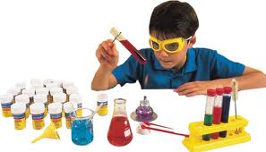
#3 Experiment (test what works the best)
Grunt:
Filling the fryer at 50% capacity but twice as often is too much work.
but filling it at 66% capacity but 1.5 times as often works out great
Also we can change the % based on how busy we are.
Idiot Night Manager:
Good job, nerd!
District Manager:
Since we hired Grunt, we are selling more fries
customers say the fries are fresher and crispier
Outcome:
Grunt gets promoted to “thinking” position
Idiot Manager has to follow Grunt’s nerdy fry cooking process any way.

Slide 23
#4 Identify bad ideas and do the right thing.
Student #1 goal
My goal is to minimize the amount of work to do on this project.
Student #1 idea
I will just copy text from Wikipedia.
Student #2 identifies bad idea
That’s plagiarism and it might lead to you having to do more work.
Outcome:
Student #1 gets
a zero on project,
fails the course
must take the course again
must redo project next semester anyway
Student #2 ends up doing a lot less work on the project than student #1.

Slide 24
Components of an Information System
Actors
Instructions
Bridge
Hardware
Software
Data
Procedures
People
Computer Side
Human Side
Automation: Move work from human side to computer side
More difficult to change

Slide 25
MIS helps build understanding
We have studied how MIS transforms data into information and then beyond
Correctness
Wisdom
People
Understanding and developing principles and concepts
Knowledge
Computers and Systems
Understanding patterns
Information
Adding value, context, relationships, and patterns
Data
Understanding

Slide 26
Components of an Information System
The benefits of automation is not just to do things automatically.
What are the real benefits of automation?
Automation: Move work from human side to computer side
More difficult to change
Hardware
Software
Data
Procedures
People
Computer Side
Human Side

Slide 27
2 big benefits of IS automation
Agility
Growth
People are often
slow to change
Often hard to retrain
Replacing people with computers (hardware) helps businesses become more agile.
Business processes can be changed easier if they are implemented with hardware or software.
Procedures are often
ambiguous
not formally defined
tedious
difficult to follow
Replacing procedures with programs (software) helps business to grow
Business processes can be scaled up easier if they are implemented with software or hardware.

Slide 28
iTunes as a System
Hardware
Software
Data
Procedures
People
Examples?
Examples?
Examples?
Examples?
Examples?

Slide 29
iTunes as a System
Hardware
Software
Data
Procedures
People
User devices:
iPhone
iPad
MacBook
Apple side:
Media Server
Infrastructure:
Network
Routers
User devices:
iTunes itself
Mac OS
Apple side:
Media Content Management System
Media itself
Music
Movies
TV Shows
Apps
Games
User:
Create account
Login
Buy song
Apple Side:
Add new song
Organize songs
Advertise new songs
Content Providers:
Upload song
Get money
User: Consumer who buys songs,
Apple :
System admins
Programmers
Marketers
Content Providers:
Artists, Record Studios, App Developers, Colleges

Slide 30
Canvas as a System
Hardware
Software
Data
Procedures
People
Examples?
Examples?
Examples?
Examples?
Examples?

Slide 31
Canvas as a System
Hardware
Software
Data
Procedures
People
User devices:
PC Laptop
Admin side:
Web Server
Database Server
Infrastructure:
Network
Routers
User devices:
Web Browser Excel
Admin side:
Blackboard system itself
Database tools
Student Grades
PowerPoint files
Word Documents
Assignments
Project Descriptions
Messages
Due Dates
Student:
Login
Submit assignment
Check grades
Faculty:
Enter grades
Upload project description
Admin side: Create courses
Enroll students
Students
Faculty
System Admins

Slide 32
General System View
Information System View
VS.
Concrete & Real (i.e., not abstract)
5 components:
Hardware
Software
Data (bridge/center)
Procedures
People
Conceptual View (i.e., abstract)
8 properties:
Stakeholder
Goal
System Boundaries
Input
Processing
Output
Feedback
key in understanding systems
Control

Slide 33
iTunes
Stakeholder
Goal
Input
Processing
Output
Customer
Musician/ Artist

Slide 34
iTunes
Stakeholder
Goal
Input
Processing
Output
Customer
wants to buy a cheap song
Song selection, credit card number (money)
Check to see if card is valid,
Start download of song
Decoded audio file, can be copied on up to 8 devices (song)
Musician/ Artist
Wants to sell their music
Artist account information, encoded audio file (song)
Create artist account, song added to system
Electronic funds added to account for each song sold (money)

Slide 35
iTunes: Customer Feedback
Stakeholder
Goal
Input
Processing
Output
Customer
wants to buy a cheap song
Song selection, credit card number (money)
Check to see if card is valid,
Start download of song
Decoded audio file, can be copied on up to 8 devices (song)
Examples of Feedback:
Message: “Lagy Gada not found, did you mean Lady Gaga.”
Message: “you have $4.99 left on your gift card.”
Message: “this song is authorized on 5 devices.”
Message: “5 minutes left to download song.”

Slide 36
Feedback from a user/customer perspective
Messages that let you know what is happening
Information about your usage of the system
Is your input good?
Is your output on the way?
Helps you
correct mistakes
enter input
understand the output

Slide 37
iTunes: Artist (content provider) Feedback
Stakeholder
Goal
Input
Processing
Output
Musician/ Artist
Wants to sell their music
Artist account information, encoded audio file (song)
Create artist account, song added to system
Electronic funds added to account for each song sold (money)
Examples of Feedback:
Message: “Your song X has been purchased 74 times.”
Message: “County is not a valid category for song X.”
Message: “You have not uploaded an image for your band.”
Message: “5 minutes left to upload song Y.”

Slide 38
Key Concept: Feedback is relative to the stakeholder/goal.
Notice how similar the feedback is for customers and artists.
Why?
They are both the same kind of stakeholder.
Both users of iTunes.
Symmetric goals
Buy song
Sell song
But, iTunes has another stakeholder! Who?

Slide 39
iTunes: System Owners perspective
Stakeholder
Goal
Input
Processing
Output
Apple Corporation
Sell media (music, apps, movies, etc.)
Provide content to add value to iPhone, iPads, etc.
New features
New types of media
Create new user accounts Add new media
Promote media
Increased usage, exposure, market share
Increased
sales (money)
Examples of Feedback:
Top selling songs, shows, apps, etc.
Login/usage report including top devices used (i.e., iPhone, iPad, MacBook, PC, etc.)
Sales by media type (music, movies, etc.)

Slide 40
Feedback from the system owner’s perspective
Messages that tell you
if the system is working
how well it’s working
how close you are to achieving a goal
Apple did NOT create iTunes to generate a sales report?
The sales report is feedback, not output.

Slide 41
System Boundaries & Data Flow
1. Goal: Make a profit off the selling of music
2. Stakeholder: Apple Corp.
3. Information System Boundaries
8. Control:
New Features
People:
Customers
Musicians
Hardware:
Media Server
User devices
7. Feedback:
Usage Reports
Software:
iTunes
Data:
Songs
Account Info
Procedures:
Buy song
Sell song
4. Input:
More musicians
5. Processing: Charge customers, distribute songs, organize musicians, promote
6. Output: Electronic Funds

Slide 42
Lady Gaga Perspective
1. Goal: Sell my music
2. Stakeholder: Lady Gaga
3. Information System Boundaries
8. Control:
promote new song
People:
Customers
Admin
Hardware:
Media Server
User devices
7. Feedback: Top Selling Songs
Software:
iTunes
Data:
Songs
Account Info
Procedures:
Categorize
song
4. Input:
New songs
5. Processing: Charge customers, distribute songs, promote
6. Output: Electronic Funds

Slide 43
Dissatisfied Customer Perspective
1. Goal: Buy my favorite music
2. Stakeholder: iTunes Customer
3. Information System Boundaries
8. Control:
Pick a new song
Or stop using iTunes
7. Feedback: “AC/DC not found”
People:
Admin Musician
Hardware:
Media Server
User devices
Software:
iTunes
Data:
Songs
Account Info
Procedures:
Create new account
4. Input:
Song Selection
5. Processing: Charge customers, distribute songs, promote
6. Output: A digital song

Slide 44
Satisfied Customer Perspective
1. Goal: Buy my favorite music
2. Stakeholder: iTunes Customer
8. Control:
Buy an iPhone so I can enjoy Buckethead on the go
3. Information System Boundaries
7. Feedback: “Buckethead album on sale”
People:
Admin Buckethead
Hardware:
Media Server
User devices
Software:
iTunes
Data:
Songs
Account Info
Procedures:
Create new account
4. Input:
Credit Card #
Song Selection
5. Processing: Charge customers, distribute songs, promote
6. Output: A digital song

Slide 45
Key Concept: Feedback is not output
“you have $4.99 left on your gift card.”
Consumers do NOT login to iTunes to find out how much money they have left on a gift card.
The goal is to get and listen to music
“County is not a valid category for your song.”
Artists do NOT login to iTunes to figure out how to spell “Country.”
These messages are forms of feedback, not output!

Slide 46
Feedback
Output
VS.
All feedback is a form of output because it comes out of the system
But, feedback is specific output that
helps stakeholders use a system
tells owners if a system is working
Pure output is more directly connected to the goal or purpose of a system.
If you want to buy a song from a system, the output is the song.
What if the goal of a system is to generate a sales report?

Slide 47
Great Examples
Cash Register System
Facebook
Goal: In the 1980’s McDonalds wanted to track sales in real time so they invest in a computerized cash register system. Real time sales reporting will help them improve their supply chain.
Sales Report
Output or feedback?
Goal: In 2008, McDonalds wanted to use social networking to distribute coupons to better promote its new menu items. Hopefully sales for the new items will improve once the coupons are on Facebook?
Sales Report
Output or feedback?

Slide 48
Great Examples
Canvas
Canvas
Goal: Professor wants to share grades with students.
Problem: Students keep asking for their grades in class
Investigation: Professor notices that students have never logged in.
Solution: Professor shows students how to login.
Student Login Report
Output or feedback?
Goal: Professor wants to track if students are clicking on the assigned case studies
Input: Case Studies (Word Documents)
Processing: Students login, navigate to case studies, click on document, Blackboard tracks the clicks.
Student Click Report
Output or feedback?

Slide 49
Input vs. Control
Input is what you put into the system.
It is typically processed in some way to produce output.
You input fuel into a car and the car produces forward movement
From Apple’s perspective, you put musicians and customers in iTunes and money comes out.
Input is usually a noun: Fuel, a song, a grade, money, raw data, potatoes, a musician.
Control is how you might change the system
Control is usually a verb.

Slide 50
Examples of System Control
Deep Fat Fryer: Raise the cooking temperature
Facebook: Restrict wall posting to only close friends
Canvas: Show only my active courses
Assembly Line: Increase production by 20%
iTunes: Block artists from uploading Microsoft file formats
Furnace: Limit the output to 71 degrees

Slide 51
System Control
Systems have variables that can be changed
And parameters that cannot be change
Variable:
Assembly line can be set to make between 0 and 20 cars per hour
We can set it to mae 10 cars per hour
Parameter:
20 cars per minute is the maximum

Slide 52
Critical Thinking Question
Setting the thermostat to 68 degrees
Is this an example of input, output, processing, control or feedback.

Slide 53
Analysis Technique
Setting the thermostat to 68 degrees
First ask two questions:
Who is the stakeholder?
What is their goal?

Slide 54
Analysis Technique
Setting the thermostat to 68 degrees
Who is the stakeholder? Me
What is their goal? To keep the room temperature at 68 degrees

Slide 55
Analysis Technique
Setting the thermostat to 68 degrees
“setting” is a verb
Could be processing or control
Control can change the processing.
But, processing directly leads to output.
What if there is no fuel?
What if the temp is already 68 degrees?
“Burning fuel” is the process to make heat
“Heat” is the output.

