Slide 1
Information Systems Serve 3 Roles
0

Slide 2
Old-fashioned Functional Areas of Business
Accounting
Marketing
Finance
Human Resources
Operations/Production

Slide 3
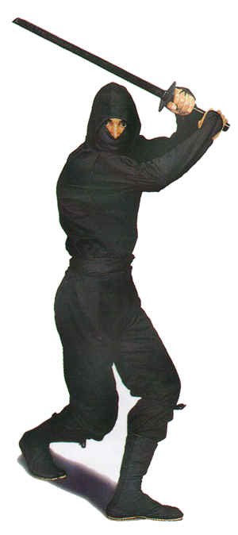
Alternative Functional Areas of Business
Accounting & Finance
Sales & Marketing
Customer Service
Manufacturing
Finance
Human Resources
Operations
Ninja Arts

Slide 4
Expanding Role of IS
0
IS was seen first at the management/tactical level
Then it was pushed down to operations
Finally, it moved up to strategic levels
Biggest advantages of IS: Information can flow up the pyramid faster and more effectively.

Slide 5
Old-fashioned Types of Information Systems
0

Slide 6
Transaction Processing System (TPS)
0
Updates Operational Databases
Examples:
ATM Machine System – Banking Transactions
Cash Register System – Point of Sale Transactions
Accounting System – Checking Account Transactions
Even AppleTV or OnDemand is a form of TPS

Slide 7
Process Control Systems (PCS)
0
Monitor and Control Industrial/Manufacturing Process
Examples:
Petroleum Refining
Power Generation
Automobile Manufacturing

Slide 8
Enterprise Collaboration Systems (ECS)
0
Teamwork, communication, and collaboration
Examples:
E-mail
Chat
Video Conferencing
Calendaring
Journaling
Workflow
File Sharing

Slide 9
Management Information System (MIS)
0
Analysis & Reporting
Charts, Graphs, Summary Tools
Examples:
SCT Banner – Managing College Information (Siena uses it)
Spreadsheet (Excel) – One of the first and most basic
Oracle's Corporate Performance Management

Slide 10
Decision Support System (DSS) Now just part of Business Intelligence Systems
0
What-if Analysis, Decision Modeling, Scenario Building, Highly interactive, ad hoc.
Examples
Most DSS’s are custom developed for specific companies; very few out-of-the-box products.

Slide 11
Executive Information Systems (EIS)
0
Provides critical info from other systems (MIS and DSS).
Portal Concept: one place with links to all information
EIS’s integrate external information such as economic developments and news about related markets and competitors.
Helps strategic decision making, not necessarily tactical.
Tactical – doing things the right way right
Strategic – doing the right things

Slide 12
Types of Info. Systems Operational Level (Spongebob Level)
Transaction Processing System
Example: Cash register system
Process Control System
Example: Assembly line system
Enterprise Collaboration System
Examples: Outlook, SharePoint, WebEX

Slide 13
Tactical and Strategic Management Level (Princess Level)
Management Information System
Static reports, aggregating data into information
Decision Support System
Interactive reports and data modeling
Executive Information Systems
Portal system, aggregates info at the strategic level, info from beyond the enterprise

Slide 14
Information Flow
0
Executives
Enterprise Collaboration System
Executive Information System
System Information Flow
Managers
DSS
MIS
Information Exchange/ Communication
TPS
PCS
Operational Systems and Staff

Slide 15
Information Flow
0
Executives
Enterprise Collaboration System
Management
Executive Information System
Managers
DSS
MIS
Operations
TPS
PCS
Operational Systems and Staff

Slide 16
Functional vs. Enterprise
Functional System
Sage Accounting
Comprehensive accounting software solution
Multi-company consolidations,
Advanced budgeting
customizable reports and financial statements.
Enterprise System
Oracle's PeopleSoft Enterprise
Customer Relationship Management
Project Management
Financial Management
Supply Chain Management
Human Capital Management

Slide 17
Example: Sage Accounting
Used for only one functional area: Accounting
What type of system is it?
Transaction Processing System – Accounting is all about processing day-to-day transactions
Management Information System – Summary reports help managers make daily, weekly, quarterly, and yearly decisions.
Helps aggregate operational data for managerial decision making.

Slide 18
Example: Oracle’s PeopleSoft CRM
What functional areas use this system?
Customer Relationship Management
(Marketing)
Project Management
(Operations)
Asset Lifecycle Management
(Accounting)
Financial Management
(Finance)
Human Capital Management
(Human Resources)

Slide 19
Real Systems rarely fit into one cell
 | PCS | TPS | ECS | MIS | DSS | EIS
Operations/ Production
Human Resources
Accounting
Finance
Marketing

Slide 20
Functional Systems are often multi-category
 | PCS | ECS | TPS | MIS | DSS | EIS
Operations/ Production
Human Resources
Accounting |  |  | Sage Accounting
Finance
Marketing

Slide 21
Robust category-based systems are often cross-functional
 | PCS | ECS | TPS | MIS | DSS | EIS
Operations/ Production |  | Google’s Collaboration Apps Gmail + Calendar + Meet
Human Resources
Accounting
Finance
Marketing

Slide 22
Where does Microsoft Excel fit in?
 | PCS | TPS | ECS | MIS | DSS | EIS
Operations/ Production
Human Resources
Accounting
Finance
Marketing

Slide 23
Where does Microsoft Access fit in?
 | PCS | TPS | ECS | MIS | DSS | EIS
Operations/ Production
Human Resources
Accounting
Finance
Marketing

Slide 24
Where does an Enterprise Database fit in?
 | PCS | TPS | ECS | MIS | DSS | EIS
Operations/ Production
Human Resources
Accounting
Finance
Marketing

Slide 25
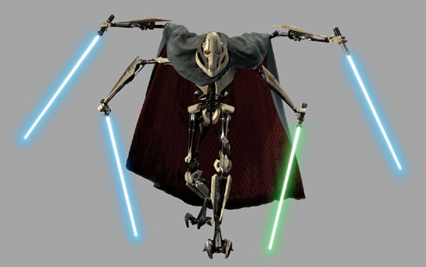
Tools vs. Complete Systems
Excel is often a tool used in a bigger system.
Tools are often general purpose; they are flexible and robust.
General purpose: Excel can be used as a calculator to add up Easter eggs or to add the cost of an F-35 jet fighter.
Robust: Excel has plug-ins to do quantum mechanics or financial calculations.

Slide 26
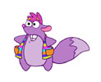
Components vs. Complete Systems
A DBMS (like Access) is also a tool for managing raw data.
But a DBMS is also a key component in bigger systems (like Sage Accounting or PeopleSoft).
PeopleSoft is actually built “on top of” an Oracle Enterprise DBMS.

Slide 27
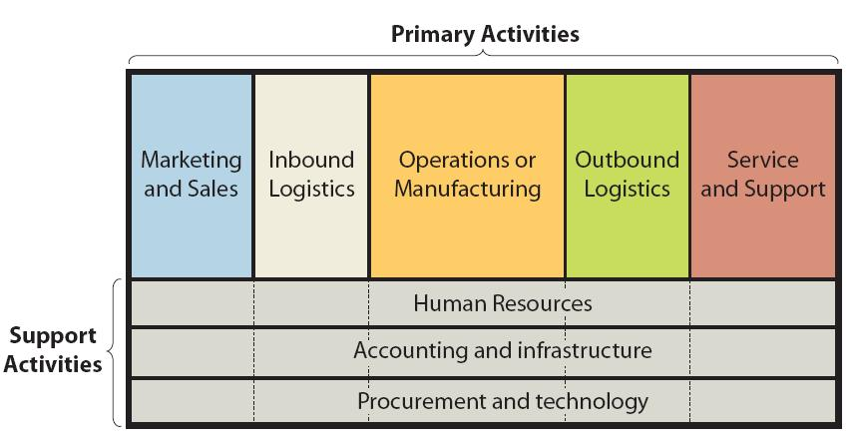
Another way to look at Information Systems
Porter’s value chain

Slide 28
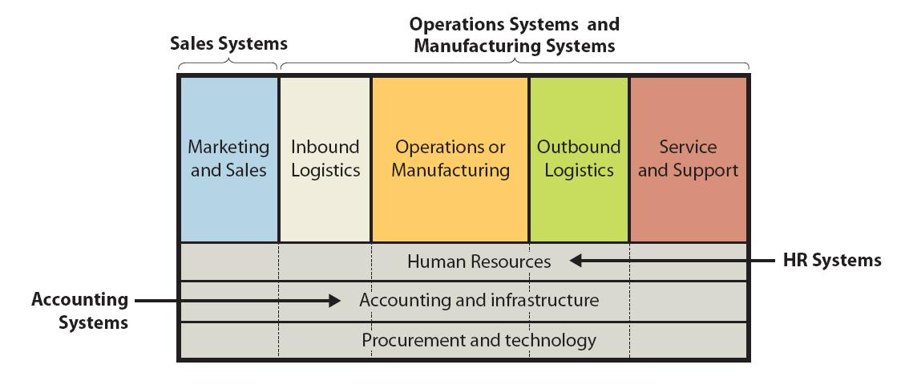
Where functional system fit
How 4 of the 5 functional systems directly support the value chain

Slide 29
Why are cross-functional system really valuable?
Marketing is so connected to service and support.
Future sales come from customer loyalty and care
Why manage these with two separate systems?
Instead combine into one system:
Customer Relationship Management (CRM)

Slide 30
Why are cross-functional system really valuable?
Accounting and HR support the entire value chain.
Why manage these with two separate systems?
Combining an HR and Accounting systems creates efficiencies

Slide 31
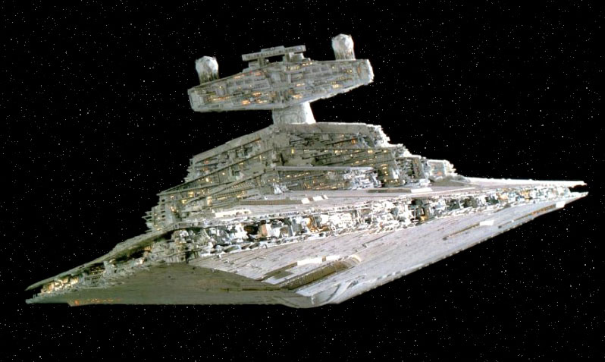
Enterprise Systems Instead of integrating 2 or 3 functional area, it integrates all the areas
ERP (Enterprise Resource Planning)
Even more integration than a CRM
ERP = CRM (Marketing & Operations) + Accounting + HR + a little bit of Finance
SCM (Supply Chain Management)
Unique in the sense that it often combines three or more enterprises
Supplier, Retailer and Customer

