Slide 1
What is Web Design
The term “web design” has come to encompass a number of disciplines, including:
Visual (graphic) design
User interface and experience design
Web document and style sheet production
Scripting and programming
Content strategy
Multimedia

Slide 2
Design
Often, when we think of design, we think about how something looks. On the Web, the first matter of business is designing how the site works.
Interaction Design (IxD)
User Interface (UI) design, and
User Experience (UX) design.

Slide 3
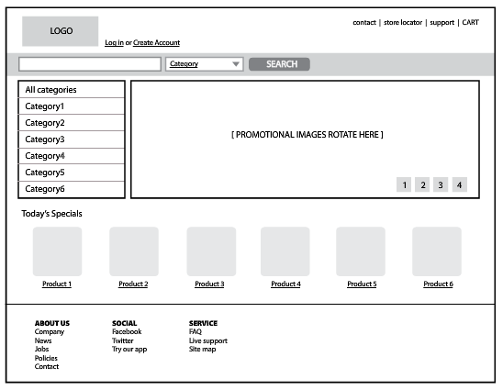
Design: Wireframes

Slide 4
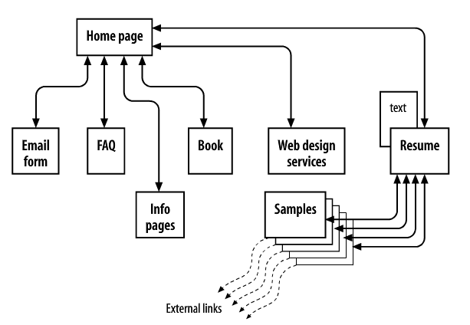
Design: Site Diagram

Slide 5
Visual/Graphic Design
This is where we focus on the “look and feel” of a website.
logos, graphics, type, colors, layout, etc.
Ensure consistency with the brand/message of the organization
Sketches of the way the site might look
producing the graphic files optimized for delivery over the Web

Slide 6
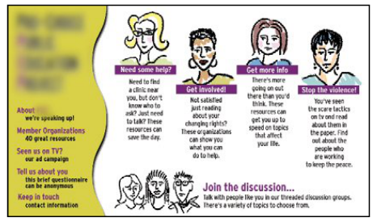
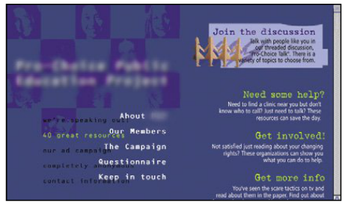
Visual/Graphic Design

Slide 7
Visual/Graphic Design
Key Languages and Software
CSS
GIMP2
Adobe Photoshop
Fireworks
Flash

Slide 8
Website Development
Content Authoring
Content Markup (HTML)
Styling (CSS)
Scripting & Programming (JavaScript)

Slide 9
Development: Backend vs. Frontend
Web Browser
Graphic design
Image production
Interface design
User experience
HTML markup
CSS styles
JavaScript
Web Server
Processing Forms
Database Programming
Content Management Systems
Server-side Scripting
Server-side Java, PHP, ASP, Ruby, JSP

Slide 10
Multimedia
Unlike other documents web pages have many layers capable of combining almost any form of media
Text
Audio
Video
Animation
Programs & Application ← Interaction as a form of media

