Slide 1
Chapter 2
Core concepts: web browser (client) vs. web server, URLs, HTTP request/response, Internet vs. WWW

Slide 2
History
Before designing web pages it is important to know how it all came about… Internet → WWW

Slide 3
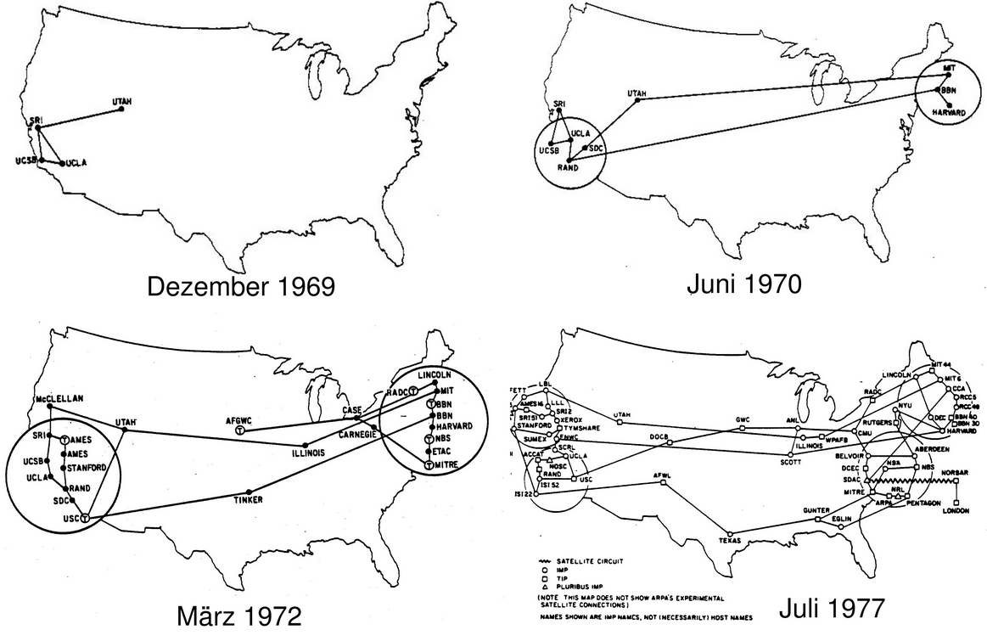
ARPAnet
ARPA (Advanced Research Projects Agency)
1968, Cold War, Military Applications

Slide 5
ARPAnet
Originally, Custom--made network applications for sharing data and messages 1968-1973
1971 Email concept developed
75% of the ARPAnet traffic
1973 File Transfer Protocol (FTP)
General/Generic service concept

Slide 6
ARPAnet → Internet
Transition Period 1971-1983
Packet Switching developed and perfected
Robust, fault-tolerant, efficient, survivable
TCP/IP protocol
ability to connect different types of networks

Slide 7
Early Internet 1983-1989
No web browsers, no web pages at all…
Only…
Email
FTP (document and image sharing)
Early message board system (BB systems)
Custom client server applications

Slide 8
Early Internet 1983-1989
ARPAnet was a government project,
But, the government always outsources
Major telecom companies (AT&T for example) are contracted “lay lines”
They lease lines to the government, but can lease or sell service to others.
Banks and IBM are the first major customers to pay for Internet access
Then, companies like Prodigy emerge and sell access to home users

Slide 9
Key Internet Concept
The government encouraged the telecom companies to cooperate, i.e., connect their networks rather than create separate independent networks
TCP/IP made it possible to connect very different types of networks
Packet Switching helped clear up data traffic jams
Banking and Research lab data travels on the same network, but to read the data requires having exactly the right software.

Slide 10
In 1989 came the WWW
Key WWW concepts
Hypertext concept – Documents can have links to other documents, just click the text
URL concept – Documents, computers, virtual mailboxes, networks can all have uniform identifier to help locate them

Slide 11
Tim Berners-Lee (TBL)
Recognized as the inventor of WWW
Proposed and developed
HTML
The URL concept
Implemented
The first web browser
The first web server

Slide 12
Before the WWW, finding stuff was hard
On the Internet you had know lots of info
numeric IP addresses to locate servers
Login and passwords to access servers
Know the folder hierarchy to find files
People would share above info via Email.
The idea of browsing the Internet was impossible
If you didn’t have access to connection info, you couldn’t find or get anyting

Slide 13
WWW instead of Internet
HTTP instead of FTP and file servers.
Web Browser instead of FTP client
Web Server instead of FTP server
URLs instead of numeric IP addresses
Clicking Hyperlink instead of navigating through folder hierarchies
Universal/Standard document formatting HTML instead of text, binary and proprietary documents (word, pdf, postscript)

Slide 14
Important differences
Internet
Nuts and bolts
Hardware
TCP/IP
Packet Switching
Network of Networks concept
World Wide Web
Content layer of Internet
Software
HTTP
URLs
Hyperlink/Hypertext concept

Slide 15
A final metaphor
Terms used interchangeably by general public and media
But, you should know
The boat: WWW helps navigate the Internet
protocols for getting data
standards for formatting data
conventions for locating data.
The river: The Internet is really the “transport medium” of the WWW.

Slide 16
1985-1993: Toddler Phase
1985 ARPAnet become NSFnet
Available at most major universities
1989 TBL invents first web browser and server
Widely recognized as the birth of WWW
1991 Al Gore helps pass key legislation
Public $$$ to expand Internet to commercial sector
1993 Mosaic is developed
first good graphical web browser

Slide 17
1993-1995: Puberty
1993 InterNIC is formed, which centralizes the management of URL and domain names
Later it become IANA
IANA is responsible for regulating companies like goDaddy and Network Solutions
1995 NSFnet become a research-only network
Internet traffic starts to get routed through a commercial networks
Major players include: Sprint and AT&T
Cable TV companies now own large parts of the physical network

Slide 18
Commercialization Period 1995-2000
1995 – Netscape become a household name
Sells web server software
Gives away browser for free
Reaches 90% market share by 1996
1996 Microsoft races to compete
Internet Explore, IIS Web Server

Slide 19
Commercialization Period 1995-2000
1997-1999 Microsoft tries to put Netscape out of business
Two different HTML standard arise
One for Netscape, one for Internet Explorer
Browser plug-ins heavily utilized
Flash, RealMedia, etc.
1997-2000 – E-commerce Commercial Explosion
Amazon, E-bay, Online Stock Trading, MP3 trafficking, etc.

Slide 20
Browser Wars 1996-1999
Microsoft (Internet Explorer) and Netscape compete to be the #1 browser.
In ’96 Netscape dominated
By ‘99 Internet Explorer was #1
Microsoft Integrated IE into the Windows OS and it was often forced upon people as the default browser
Microsoft paid billions in lawsuit (EU mostly) but still won the war

Slide 21
Browser Wars 1996-1999
In 2000, AOL buys out Netscape, which is was failing financially
This marks the end of the war and beginning of Microsoft’s dominance in the WWW.
Netscape makes its source code open, so developers can build upon it.
Leads to the Mozilla Foundation, which eventually develops Firefox.

Slide 22
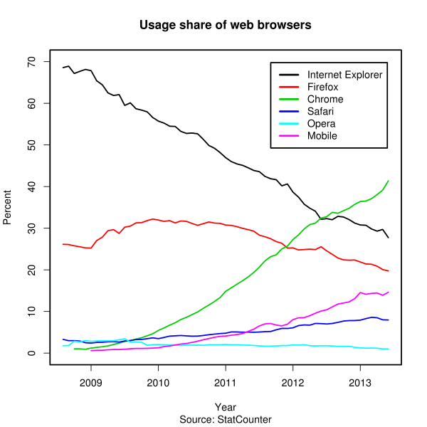
Current Market Shares
http://en.wikipedia.org/wiki/Usage_share_of_web_browsers

Slide 23
Browser Wars - Significance
Early competition led to great innovation
Web Browsers were suppose to be simple programs that could render HTML code.
Now browsers are heavy-weight applications (JavaScript, Silverlight, Flash plug-ins, etc.)
Microsoft’s decade of dominance was terrible.
Tried to make the WWW a proprietary product
No regard for recognized standards

Slide 24
URL
Uniform Resource Locator
The location part of the URI (Uniform Resource Identifier)

Slide 25
URLs/URIs can be complex
http://en.wikipedia.org/wiki/URI_scheme

Slide 26
Default Files
Depends on Web Server
https://www.facebook.com/ will load
https://www.facebook.com/home.php
In general
https://www.server.com/ will load
https://www.server.com/index.html

Slide 27
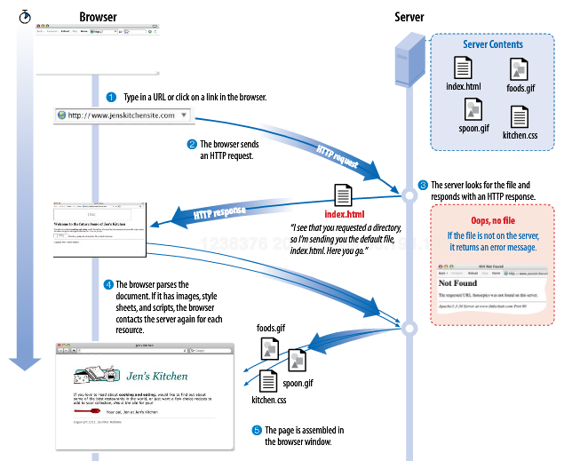

Slide 28
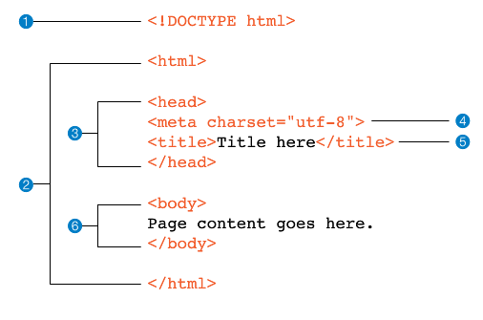
Basic HTML Document

