Slide 1
Chapter 4 & 5
pp 69 - 102

Slide 2
HTML Elements & Attributes
Format
<tagname attribute=“value”> Content </tagname>
Or
<tagname attribute=“value”>
Examples
<a href=“pagename.html”> This Text Is A Hyperlink </a>
<img src=“pic.jpg” width=“200”
alt=“Picture of Eric Breimer”>

Slide 3
Inline Elements
Examples:
  <strong> or <b>
  <em> or <i>
  <a>
Creates an invisible box around the text being formatted
  This is an <b>important</b> word
  This is an important word
No border, padding or margin in or around the box

Slide 4
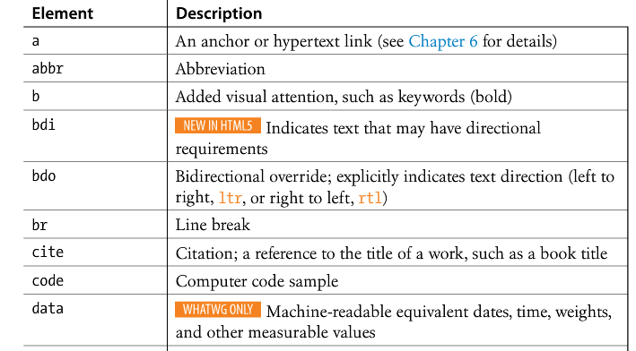
Inline elements

Slide 5
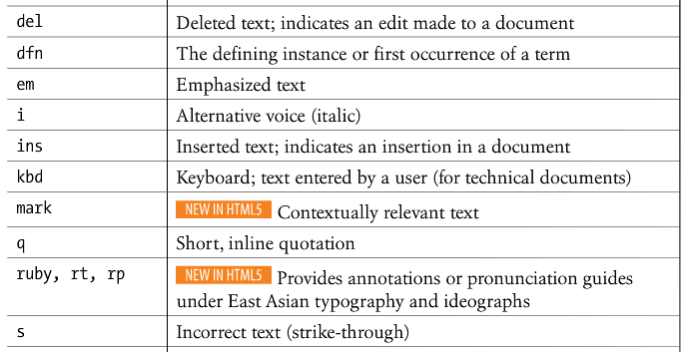
Inline elements

Slide 6
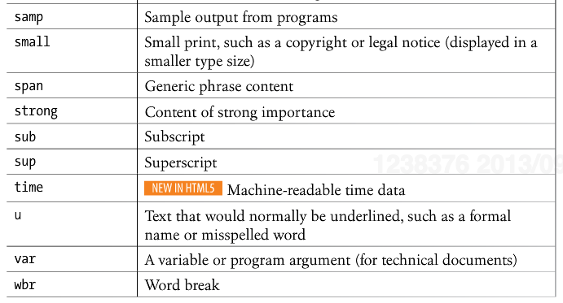
Inline elements

Slide 7
Block Elements
Examples:
  Paragraphs <p>
  Headings <h1>, <h2>, …, <h6>
  Lists <ul>, <ol>, <li>
Takes up the entire width of the web browser’s window
Top and bottom margins
  16px = 1em = height of 12pt line of text

Slide 8
Lists
Unordered
(Bulleted lists)
<ul>
<li>First</li>
<li>Second</li>
<li>Third</li>
</ul>
Ordered
(Numbered)
<ol>
<li>First</li>
<li>Second</li>
<li>Third</li>
</ol>
First
Second
Third
First
Second
Third

Slide 9
Lists
<ul> and <ol> have 36px of left padding
For each <li>, the bullet is positioned at -16px
Seeing and example is worth a 1000-word explanation

Slide 10
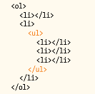
Nesting in HTML
Lists are a great example of how HTML elements can be nested inside each other to create a hierarchy

Slide 11
Blockquotes
<blockquote>The quote goes here</blockquote>
Often misused to create indents
Indicates a long quotation
It is not considered part of the document outline

Slide 12
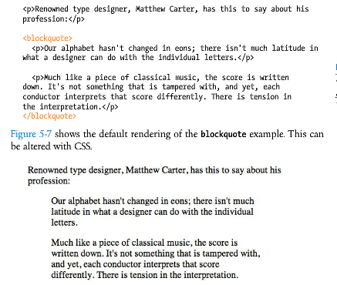

Slide 13
Pre-formatted text
Web browsers ignore extra “white space.”
Only one “space” is displayed between words and elements
Extra spaces, tabs, and line breaks are not displayed at all.
The <pre> tag allows extra spaces, tabs, and line breaks to be displayed.
Why do web browsers ignore extra “white space?”

Slide 14
Figures
<figure>
<img src=“piechart.jpg” alt=“This will pop up”>
<figcaption>This will display on screen</figcaption>
</figure>

Slide 15
Organizing with new HTML5 tags
<header>
<footer>
<section>
<article>
<aside>
<nav>

Slide 16
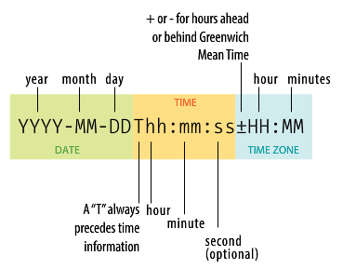
Time and dates

Slide 17
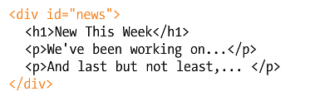
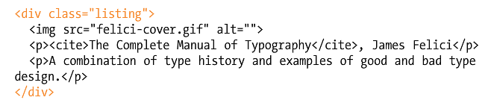
Span and Div

Slide 18
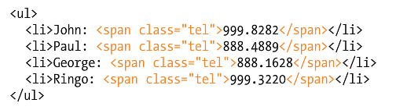
Span and Div

Slide 19
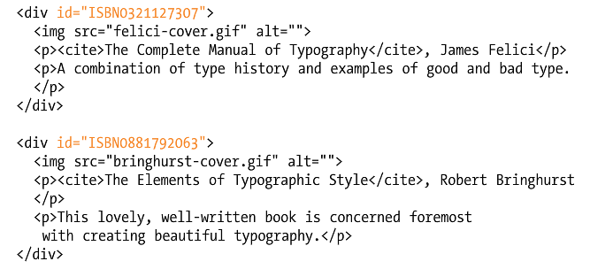
Class vs. id

Slide 20
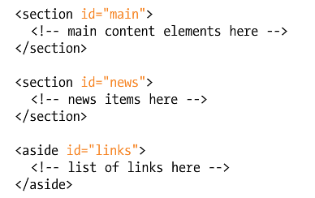
Class vs. id

Slide 21
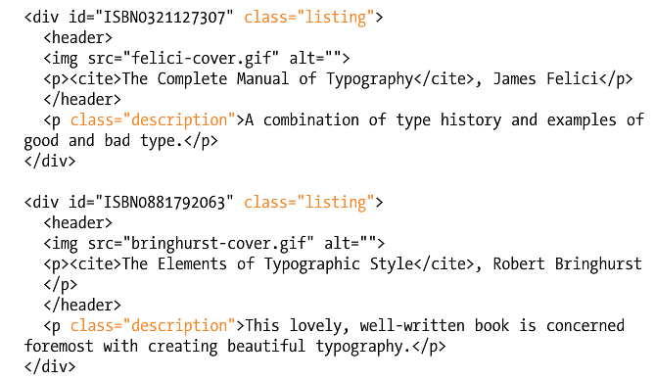
Class vs. id

