Slide 1
Chapter 6
pp 105-121

Slide 2
Announcements
Project 1 coming up (details on Monday)
Lab 2 deliverable (submit on Blackboard)
Lab 3 pre-lab quiz is up.

Slide 5
Absolute URLs
Usually points to an external website
href=“http://www.go.com/fun.html”

Slide 6
Relative URLs
Must point to a file on your server
href=“fun.html”
In the example above, fun.html must be in the same folder as the web page that contains the href above.

Slide 7
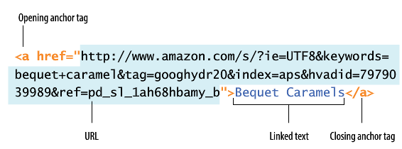
HREFs can be long

Slide 8
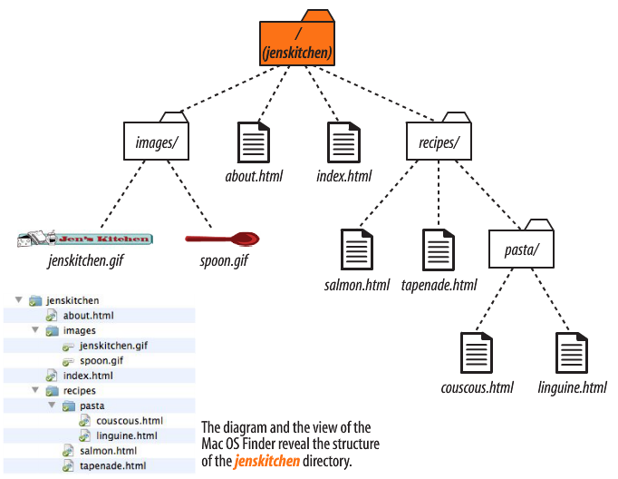

Slide 9
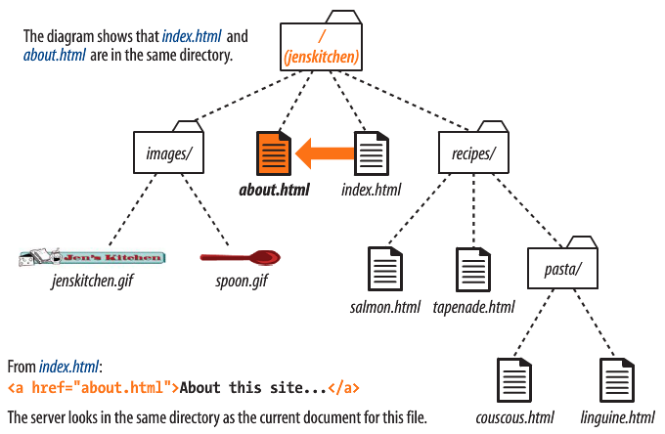

Slide 10
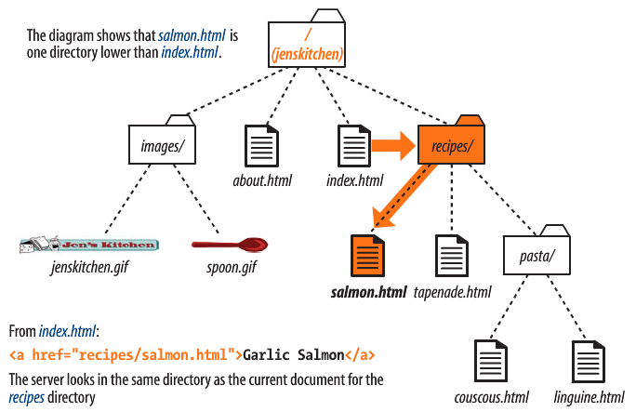

Slide 11
In index.html, link to linguine.html

Slide 12
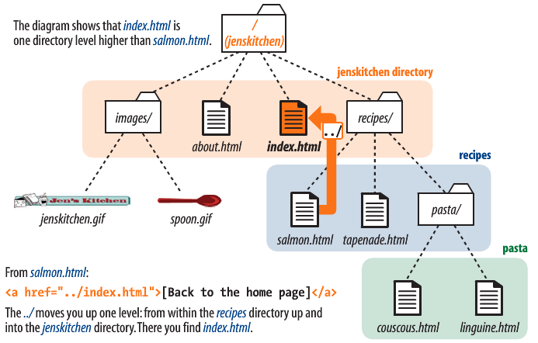

Slide 13
In linguine.html, link to about.html

Slide 14
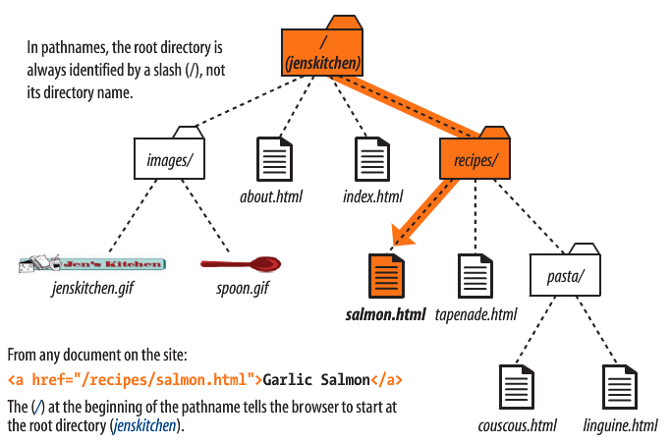

Slide 15
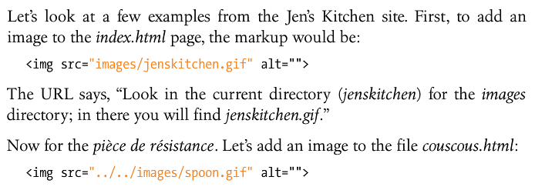
Inserting Images

Slide 16
In about.html, insert spoon.gif

Slide 17
In salmon.html, insert spoon.gif

Slide 18
In couscous.html, insert jenskitchen.html

Slide 19
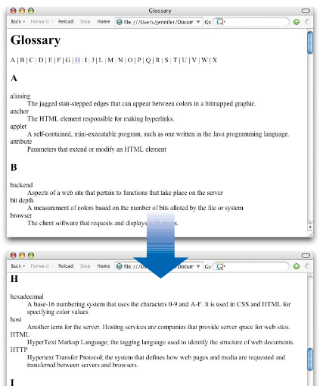
Linking inside a page

Slide 20
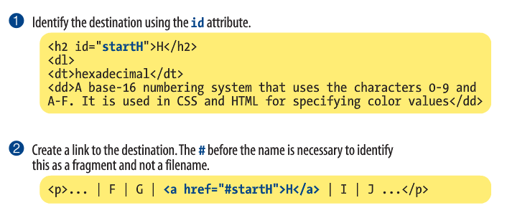
Linking inside a page

