Slide 1
HTTP Request/Response Process
Enter URL (http://server.com) in your browser’s address bar.
Your browser uses DNS to look up IP address of server.com
Your browser issues a request for index page at server.com.
The request includes the IP address of your computer
server.com looks for the web page on its hard disk.
server.com returns the web page to your IP address
Your browser receives and renders the web page

Slide 2
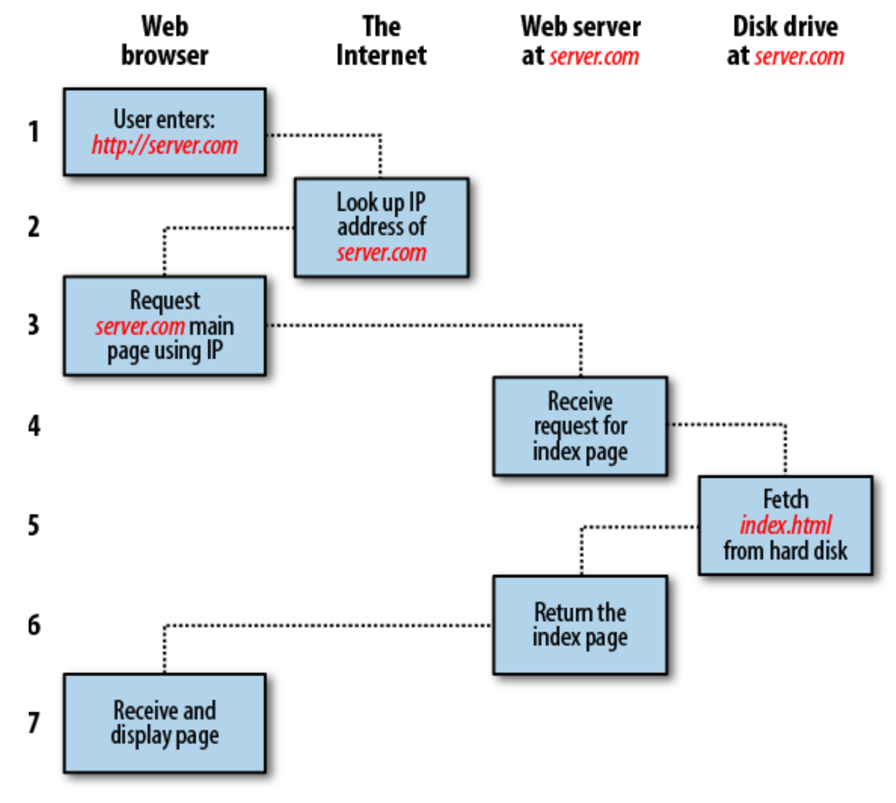

Slide 3
Client
Chrome Web Browser
Server
Apache Web
Server
time
Request with URL and client IP
Response with HTML document
Request with URL and client IP
Response with HTML document

Slide 4
HTTP Procedure with PHP & MySQL
Enter URL (http://server.com) in your browser’s address bar.
Your browser uses DNS to look up IP address of server.com
Your browser issues a request for index page at server.com.
The request includes the IP address of your computer
server.com looks for the web page on its hard disk.
server.com notices that the web page has PHP code.
server.com invokes PHP interpreter to execute the PHP code.
PHP interpreter executes MySQL connect function and query
MySQL database returns query results
PHP interpreter uses result to generate/output web page
server.com returns the web page to your IP address
Your browser receives and renders the web page

Slide 5
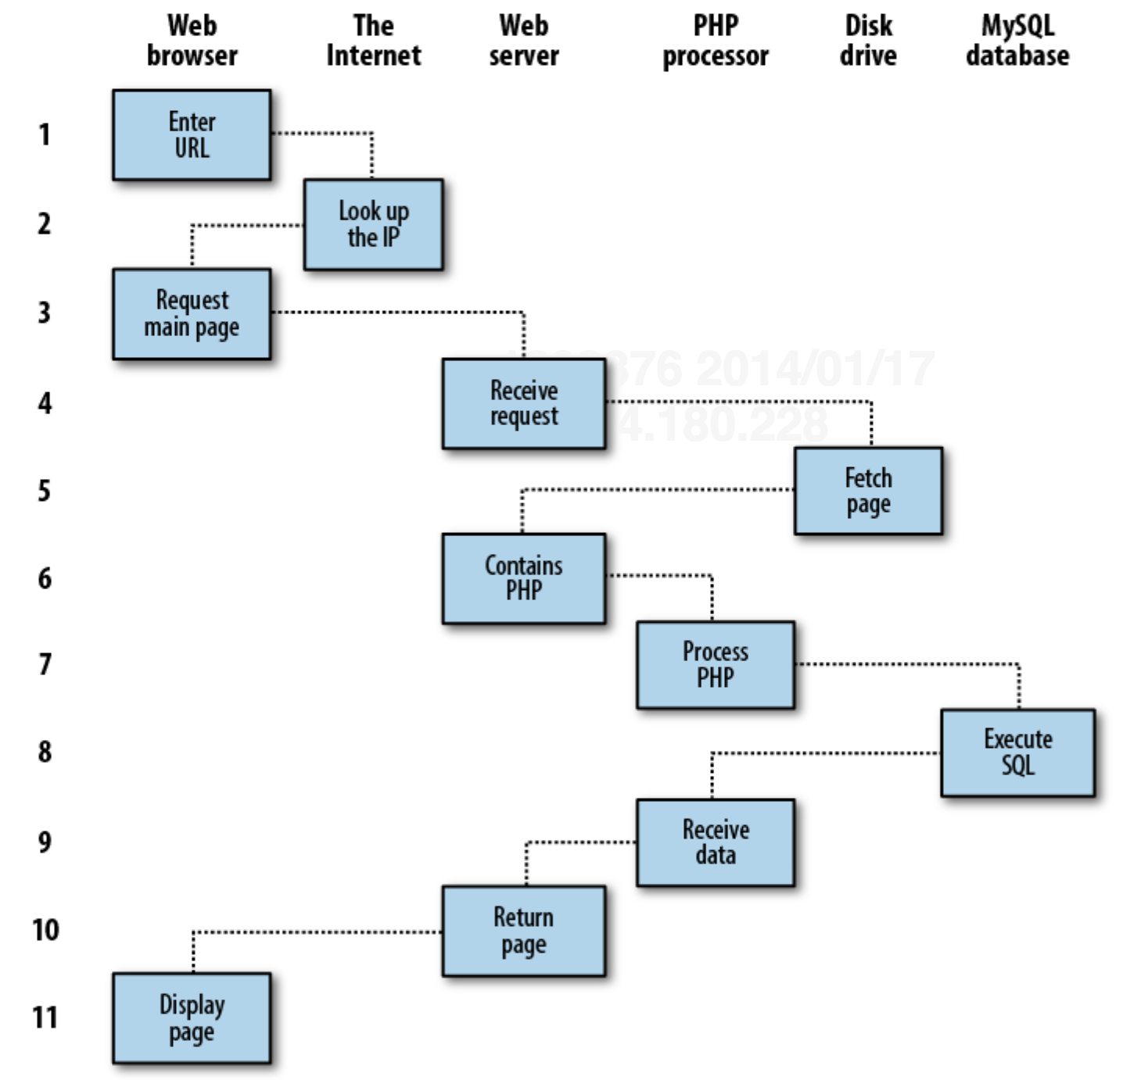

Slide 6
Client
Chrome Web Browser
Server
Apache Web
Server
Database
MySQL DBMS
Server
Request with URL and client IP
URL is a PHP program
PHP program connects to MySQL
Query results are sent
PHP program
receives results
processes them and
generates HTML
document
Response with HTML document

Slide 7
3 Layers of a web page
Content (not really a layer)
  The text, images, audio, and video
Structural Layer
  HTML elements used to markup content
Presentational Layer
  CSS code to decorate the HTML elements
Behavioral Layer
  JavaScript code that can dynamically change anything on the page

Slide 8
Confusion: 3 Layers vs. 3 Tiers
Web Page has 3 Layers
HTML – Content, structure, semantics
CSS – Styles, presentation, layout
JavaScript – Interaction, behavior, client-side processing
Web Application are implemented with 3 Tiers
Client – Web browser, user device, chrome
Server – Web server, server-side processing, PHP
Database – DBMS, tables that store content, MySQL

Slide 9
Tiers of a web application
Client Tier
  web browser or HTML rendering engine
    Sometimes rendering engines are built into other applications.
  Responsible for displaying a web page
    HTML and CSS rendering
    JavaScript interpreter
  Examples:
  Chrome, Firefox, Safari, Internet Explorer, Opera, web viewer built into Facebook mobile app.

Slide 10
Tiers of a web application
Server Tier
  The web server, daemon software
  Responsible for responding to HTTP requests and server-side processing
  Examples:
  Apache, Microsoft IIS, nginx, Google’s GWS, Java System Web Server, Node JS
  Server-side scripting languages:
  PHP, ASP, JSP, ColdFusion, Ruby, Perl, Python, etc.

Slide 11
Tiers of a web application
Database Tier
  Database server
  Responsible for storing and managing raw content
  Examples: MySQL, Microsoft’s SQL Server, Oracle 8i or rDB, IBM’s DB2, PostgreSQL, SQLite, etc.

Slide 12
HTML
HyperText Markup Language
A simple text document can be “marked-up” with tags to specify how it should be interpreted.
<h1>Level 1 Header</h1>
<p>This is a paragraph…</p>

Slide 13
Semantics
HTML is supposed to be a structural or semantic language,
  Browser Wars led to the introduction of “style” or formatting tags.
  Formatting tags have been removed from the HTML standards (called deprecation).

Slide 14
CSS
Cascading Style Sheets
Used to specify the style/appearance of structural elements (HTML tags).
CSS was part of the original design of the web,
but it was not widely used during the browser wars.

Slide 15
CSS
p {
text-indent: 16px;
font-weight: bold;
}
table {
border: 1px solid black;
}

Slide 16
JavaScript
…nothing to do with Java programming languages
1994 Developed by Netscape
  called Mocha, LiveScript, and then JavaScript
1995 Microsoft developed Jscript for IE
1996 Standard language called ECMAScript was proposed and eventually adopted by W3C
1999 Most major web browsers followed the ECMA standard, but the name JavaScript stuck.

Slide 17
About JavaScript
JavaScript has become a mature application development language.
A powerful web server called node.js is implemented with JavaScript and uses it for server-side application scripting.
Google’s Chrome browser uses JavaScript to implement many of its UI features.
Some recent surveys indicate that JavaScript is the #1 language employers look for on resumes

Slide 18
HTML & Javascript
<!DOCTYPE html>
<html>
<head>
<script>
function displayDate() {
document.getElementById("demo").innerHTML=Date();
}
</script>
</head>
<body>
<h1>My First JavaScript</h1>
<p id="demo">This is a paragraph.</p>
<button type="button" onclick="displayDate()">Display Date</button>
</body>
</html>

Slide 19
PHP
A somewhat popular server-side scripting language
  http://php.net
Comes with Apache (popular free web server software)
Example:http://www.w3schools.com/php/showphp.asp?filename=demo_loop_for
PHP stands for PHP Hypertext Pre-processor, where
  The PHP stands for PHP Hypertext Pre-processor, where
    The PHP stands for PHP Hypertext Pre-processor, where
      The PHP stands for PHP Hypertext Pre-processor, where

Slide 20
MySQL
An “almost-free” database management system that integrates nicely with an Apache PHP-enabled web server.
Used to be 100% free open source
Bought by Oracle (damn!)
GNU Public license version which is still free
Does not scale up for really huge applications

